Slide 1
Module Outline
Introduction to Android
A Brief History of Android
Android Basics
Android Application Fundamentals
Developing Applications
Activities
User Interface
Application Manifest
Application Resources

Slide 2
Module Outline
Intents
Services
Data Storage
Content Provider
Media
Telephony
Wifi, Bluetooth & Networking
Sensors
Location & Maps
Debugging

Slide 3
INTRODUCTION TO ANDROID

Slide 4
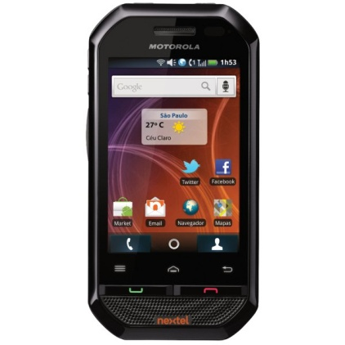

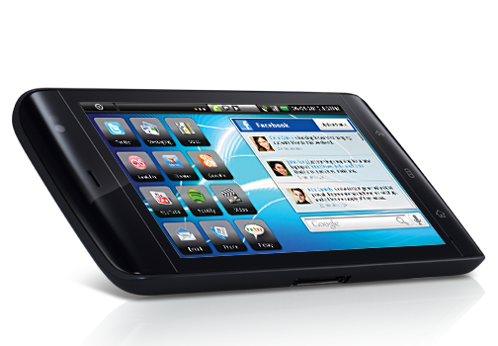
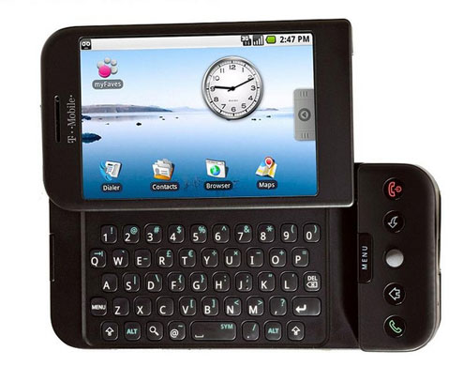
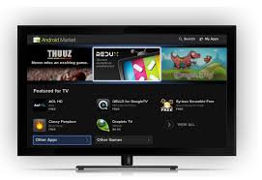
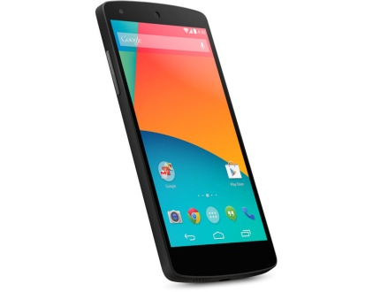
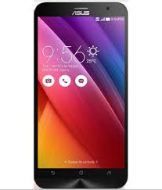
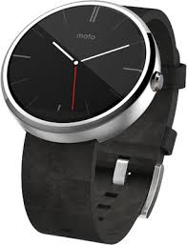

INTRODUCTION TO ANDROID
Android Devices
HTC Dream
Motorola i867
Samsung Galaxy Ace
Dell Streak
Google Nexus
Asus Zenfone 2
Moto 360
Android TV
Android is in space too…

Slide 5
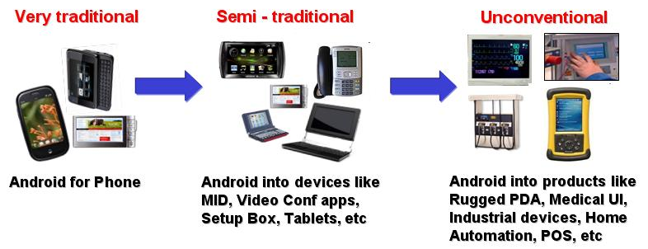
INTRODUCTION TO ANDROID
Not just a Mobile Operating System

Slide 6
A BRIEF HISTORY OF ANDROID

Slide 7
A Brief History Of Android
History
Android, Inc. was founded in Palo Alto, California, United States in October, 2003 by Andy Rubin and others
Google acquired Android Inc. in August 2005, making Android Inc. a wholly owned subsidiary of Google Inc.
On November 5, 2007, the Open Handset Alliance, a consortium of several companies which include Broadcom Corporation, Google, HTC, Intel, LG, Marvell Technology Group, Motorola, Nvidia, Qualcomm, Samsung Electronics, Sprint Nextel, T-Mobile and Texas Instruments unveiled itself with a goal to develop open standards for mobile devices.
Android has seen numerous updates which have incrementally improved the operating system, adding new features and fixing bugs in previous releases. Each major release is named in alphabetical order after a dessert or sugary treat.
Google has announced Project Brillo as a cut-down version of Android that uses its lower levels (excluding the user interface), intended for the "Internet of Things" (IoT) embedded systems.

Slide 8
A Brief History Of Android
Licensing
With the exception of brief update periods, Android has been available under a free software/open source license since October, 21 2008. Google has published the entire source code (including network and telephony stacks) under an Apache License.
Even though the software is open-source, device manufacturers cannot use Google's Android trademark unless Google certifies that the device complies with their Compatibility Definition Document (CDD).
Individual Contributor License Agreement, All individual contributors (that is, contributors making contributions only on their own behalf) of ideas, code, or documentation to the Android Open Source Project will be required to complete, sign, and submit an Individual Contributor License Agreement.
Brand Guidelines, The "Android" name, the logo, the "Google Play" brand and other trademarks are property of Google Inc. and thus not part of the assets that Google makes available through the Android Open Source Project.

Slide 9
A Brief History Of Android
Understanding Android
Kernel (Definition: The central or most essential part of something)
The Kernel is the most basic level or core of the operating system, responsible for resource allocation, file management, and security
Android's kernel is based on one of the Linux kernel's long-term support (LTS) branches
Designed primarily for touchscreen devices such as smartphones and tablets.
The specific kernel version depends on the actual Android device and its hardware platform
Android's variant of the Linux kernel has further architectural changes that are implemented by Google outside the typical Linux kernel development cycle
AOSP (Android Open Source Project)
Android has an active community of manufacturers & developers who use the Android Open Source Project (AOSP) source code to develop and distribute their own modified versions of the operating system.
Usually Code-drops every 6 months
Official AOSP branches at https://source.android.com

Slide 10
A Brief History Of Android
Code Licenses
Kernel
GNU General Public License (a.k.a. GPL)
Within Android, Linux the kernel remains a separate program, with its source code under GNU GPL ver 2.
Android is very different from the GNU/Linux operating system because it contains very little of GNU
Just about the only component in common between Android and GNU/Linux is Linux, the kernel.
AOSP
The preferred license for the Android Open Source Project is theApache License 2.0 (a.k.a. ASL)
Having GPL-free user-space was a design goal
GPL is a copyleft license, means that derived works can only be distributed under the same license terms.
A few GPL and LGPL parts: mainly BlueZ (Bluetooth) and DBUS (Message Bus System)
Some key components from BSD: Bionic (OS Compatibility) and Toolbox (System commands)

Slide 11

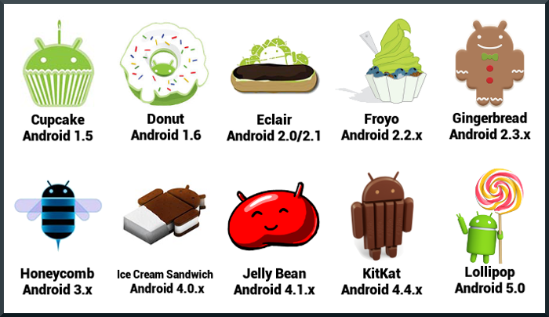
Versions
Versions
Marshmallow
Android 6.0
In June 2015, Google announced Android Marshmallow (version 6.0) with a release date of Q3 2015
As of September 2015, Android 4.4 "KitKat" is the single most widely used Android version, operating on 39.2% of all Android devices accessing Google Play. At second are different Android "Jelly Bean" versions (4.1–4.3.1), with a combined share of 33.6%. Android “Lollipop” (5.0-5.1) has a 9.7% share of Android handsets.

Slide 12
A Brief History Of Android
Version History
2008 - Sept.: Android 1.0 is released
2009 - Feb.: Android 1.1
2009 - Apr.: Android 1.5 / Cupcake
2009 - Sept.: Android 1.6 / Donut
2009 - Oct.: Android 2.0/2.1 / Eclair
2010 - May: Android 2.2 / Froyo
2010 - Dec.: Android 2.3 / Gingerbread
2011 - Jan : Android 3.0 / Honeycomb – Tablet-optimized
2011 – May: Android 3.1 – USB host support
2011 – Dec: Android 4.0 / Ice-Cream Sandwich – merge Gingerbread and Honeycomb
2012 – June: Android 4.1 / Jelly Bean – Google Now & Knowledge Graph
2013 – October: Android 4.4 / KitKat & Kitkat Wear – Optimized for 512 MB RAM, embedded smart devices & IoT
2014 – June: Android 5.0 / Lollipop – Material Design, Improved Notifications
2015 – October: Android 6.0 / Marshmallow – Redesigned Permission Model, Power Management, Google Now Context

Slide 13
ANDROID BASICS

Slide 14
Android Basics
What is Android, really?
Essentially, Android is a software stack for mobile devices that includes an operating system, middleware and key applications.
At a larger scale, Android is an Eco-system built by Google & its affiliates, which enables Android developers to build, deploy & monetize applications for a range of Android devices
The Android SDK provides the tools and APIs necessary to begin developing applications on the Android platform using the Java programming language.
The Android NDK is a toolset that lets you embed components that make use of native code (C/C++) in your Android applications.
Using an IDE (Integrated Development Environment) such as Android Studio or Eclipse, developers can build applications that utilize a Android enabled device.
The Google Developer Console enables developers to deploy their applications to the Google Play Store and track usage and other relevant analytics.

Slide 15
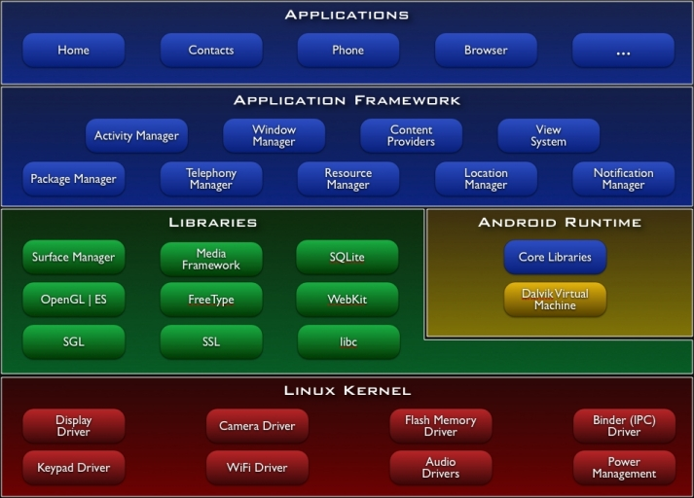
Android Basics
Android Software Stack

Slide 16
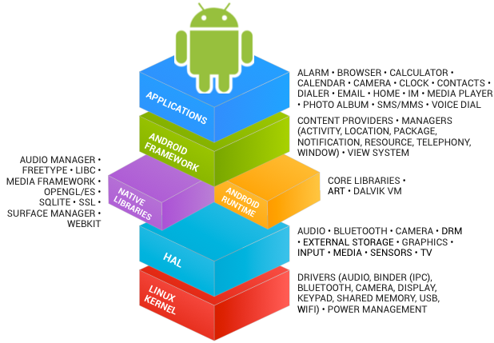
Android Basics
Another look at the Stack

Slide 17
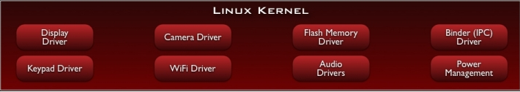
Android Basics
Android’s Linux kernel
Android 1.0 was built on Linux 2.6 kernel, currently devices mainly use 3.4 or 3.10
Provides security, memory management, process management, network stack, and driver model
Provides an abstraction layer between the device hardware and the software stack
Additional modifications have been made at an architectural level to the typical Linux Kernel
Examples of changes: Binder, ashmem, pmem, logger, wakelocks, oom handling

Slide 18
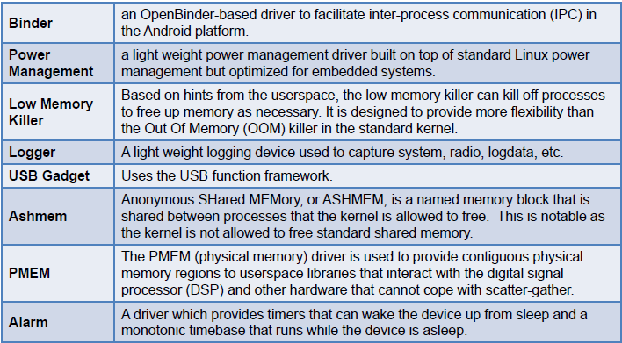
Android Basics
Kernel Modifications

Slide 19
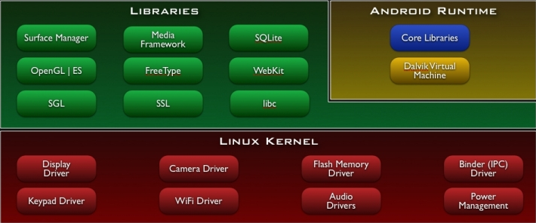
Android Basics
Libraries
A set of C/C++ libraries exposed to developers through the application framework

Slide 20
Android Basics
Libraries
System C library - a BSD-derived implementation of the standard C system library (libc), tuned for embedded Linux-based devices
Media Libraries - based on PacketVideo's OpenCORE; the libraries support playback and recording of many popular audio and video formats, as well as static image files, including MPEG4, H.264, MP3, AAC, AMR, JPG, and PNG

Slide 21
Android Basics
Libraries
Surface Manager - manages access to the display subsystem and seamlessly composites 2D and 3D graphic layers from multiple applications
FreeType - bitmap and vector font rendering

Slide 22
Android Basics
Libraries
LibWebCore - a modern web browser engine which powers both the Android browser and an embeddable web view
SGL - the underlying 2D graphics engine

Slide 23
Android Basics
Libraries
3D libraries - an implementation based on OpenGL ES 1.0 APIs; the libraries use either hardware 3D acceleration (where available) or the included, highly optimized 3D software rasterizer
SQLite - a powerful and lightweight relational database engine available to all applications

Slide 24
Android Basics
Dalvik Virtual Machine
Runtime libraries provide most of the functionality in the core Java libraries
Each app has a process and an instance of Dalvik VM
Uses Dalvik Executable (.dex) format – low memory footprint
VM is register based runs compiled Java classes
The linux kernel provides Dalvik with needed functionality

Slide 25
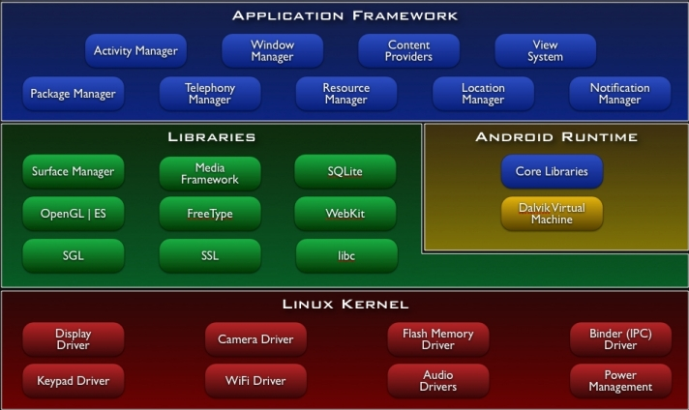
Android Basics
Application Framework
The Application Framework allows developers to build cool apps using device capabilities

Slide 26
Android Basics
Application Framework
Core System Services
Activity manager (manages application lifecycle)
Package manager (loads apk files)
Window manager (handles applications window manager interaction with surface flinger)
Resource manager (handles media resources)
Content providers (provides data to application)
View system (provides widgets, views, layouts to applications)
Hardware Services
Provides low-level access to hardware device
Location manager
Telephony manager
Bluetooth service
WiFi service / USB service / Sensor service

Slide 27
Android Basics
Applications
The non-AOSP apps
Android Market
YouTube
Maps and Navigation
Gmail
Voice
SkyMap
...
Require
CTS/CDD Compliance
Signed agreement w/ Google

Slide 28
ANDROID APPLICATION FUNDAMENTALS

Slide 29
Android Application Fundamentals
Getting Started
Setting up your Environment for Android Development
Download and install JDK version 7 & above for your OS version (32 or 64 bit)
Download and install Android Studio. (Minimum 2GB RAM, Recommended 4GB RAM)
Download the latest SDK tools and platforms using the SDK Manager.
Android Studio IDE will create emulators based on your system configuration
Alternately we may use Android ADT or Eclipse IDE for development as well

Slide 30
Android Application Fundamentals
Android Studio Features
Android Studio is the official IDE for Android development, and with a single download includes everything you need to begin developing Android apps. On top of the capabilities you expect from IntelliJ, Android Studio offers:
IntelliJ IDE + Android Studio plugin
Android SDK Tools
Android Platform-tools
A version of the Android platform
A version of the Android system image for the emulator
Flexible Gradle-based build system
Build variants and multiple apk file generation
Code templates to help you build common app features
Rich layout editor with support for drag and drop theme editing
lint tools to catch performance, usability, version compatibility, and other problems
ProGuard and app-signing capabilities
Built-in support for Google Cloud Platform, making it easy to integrate Google Cloud Messaging and App Engine
And much more

Slide 31
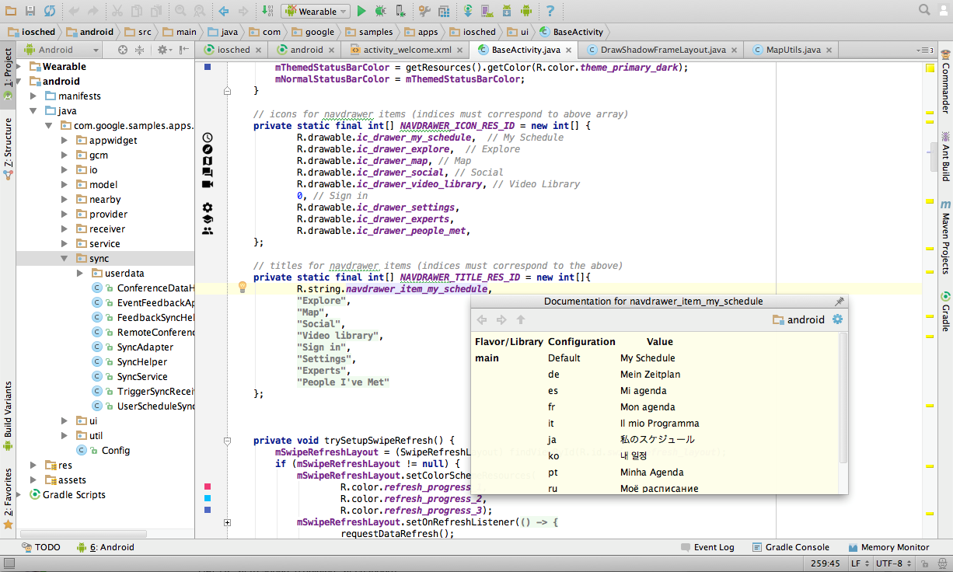
Android Application Fundamentals
Android Studio – Intelligent Code Editor
Auto population of values, methods & classes

Slide 32
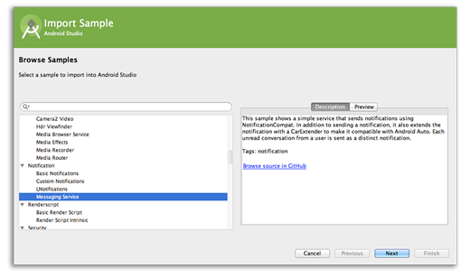
Android Application Fundamentals
Android Studio – Code templates and GitHub integration
Import code templates and view project source on GitHub

Slide 33
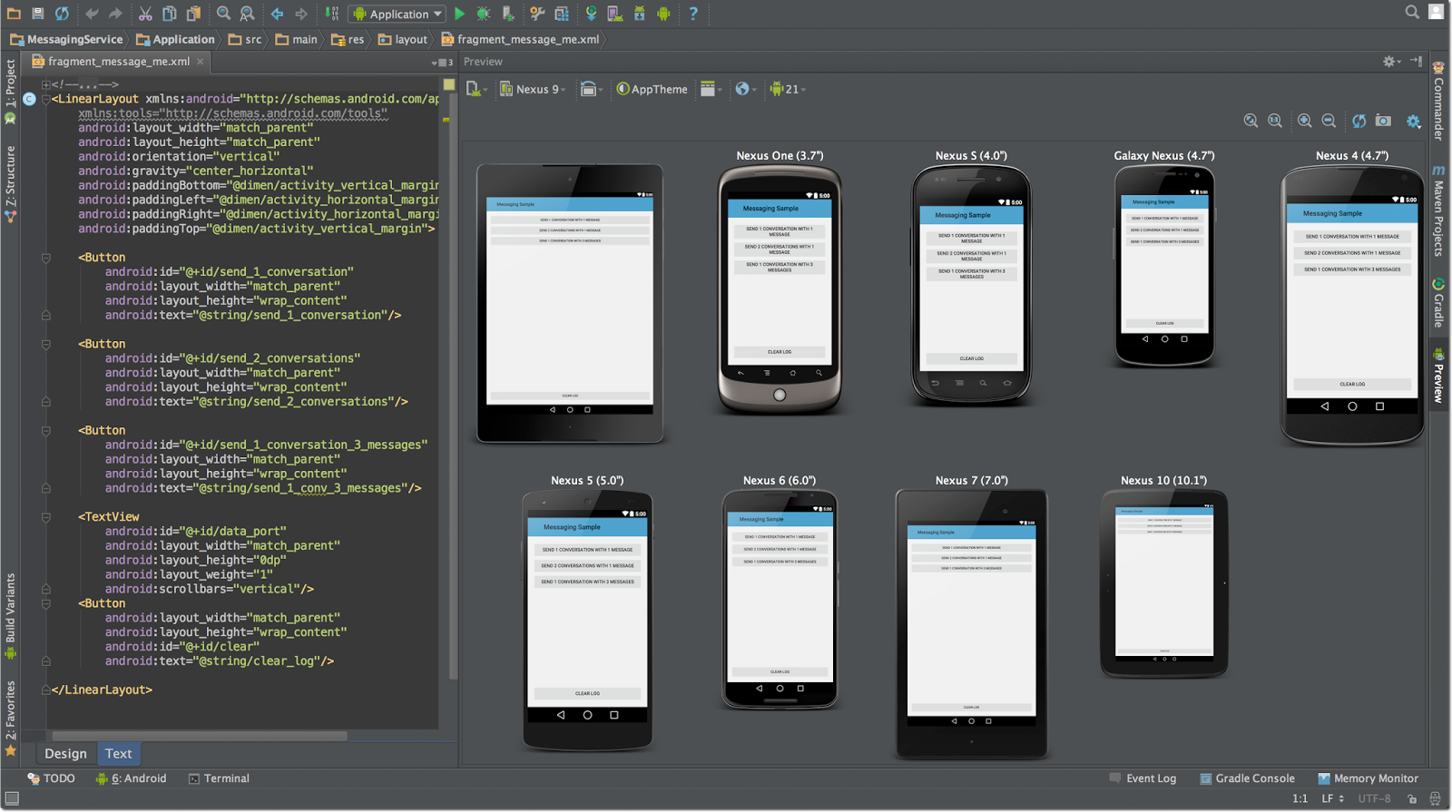
Android Application Fundamentals
Android Studio – Multi-screen app development
View code & design change impact on multiple mobile screens

Slide 34
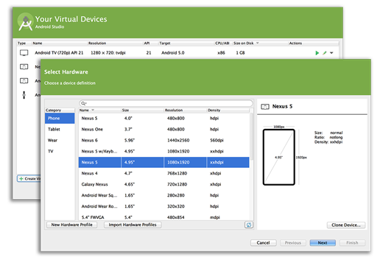
Android Application Fundamentals
Android Studio – Virtual devices for all shapes and sizes

Slide 35
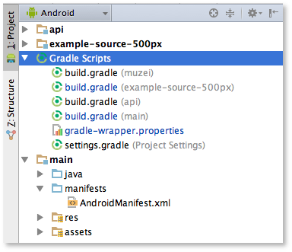
Android Application Fundamentals
Gradle
What is Gradle?
Gradle is an automated build toolkit that can integrate into lots of different environments, via plugins. In Android Studio, Gradle integration is achieved via the aptly-named Android Gradle plugin. Gradle enables developers to:
Minimize Configuration Required for New Projects
Declare Project Dependencies
Test Your Project
Generate Signed APKs
Generate Multiple APKs from a Single Module

Slide 36
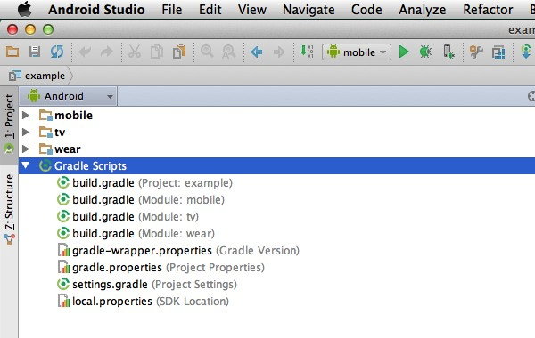
Android Application Fundamentals
Gradle Build Files
Top Level Build File
This is where you'll find the configuration options that are common to all the modules that make up your project.
Module Level Build File
Each module has its own Gradle build file that contains module-specific build settings. You'll spend most of your time editing module-level build file(s) rather than your project's top-level build file.
Other Gradle Files
In addition to the build.gradle files, your Gradle Scripts folder contains some other Gradle files. Most of the time you won't have to manually edit these files as they'll update automatically when you make any relevant changes to your project.

Slide 37
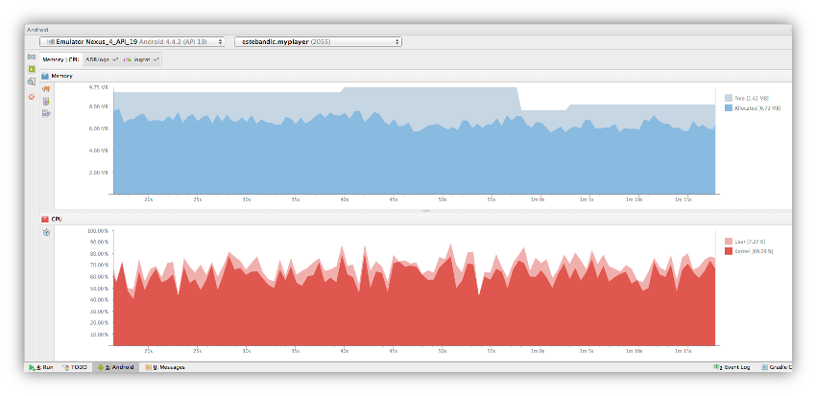
Android Application Fundamentals
Memory and CPU monitor
Real time monitoring of Memory & CPU cycle allocation for the application
Displays available & used memory/CPU in a graph and Garbage collection over time

Slide 38
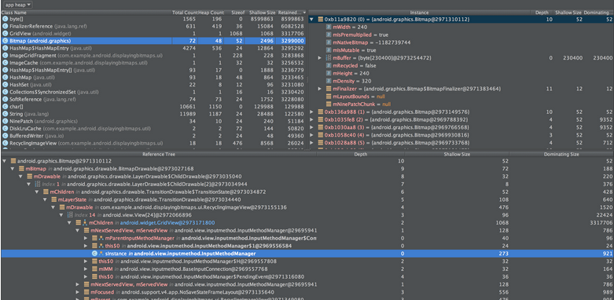
Android Application Fundamentals
Heap Dump
Track type of memory used, object leaks & compare application statistics

Slide 39
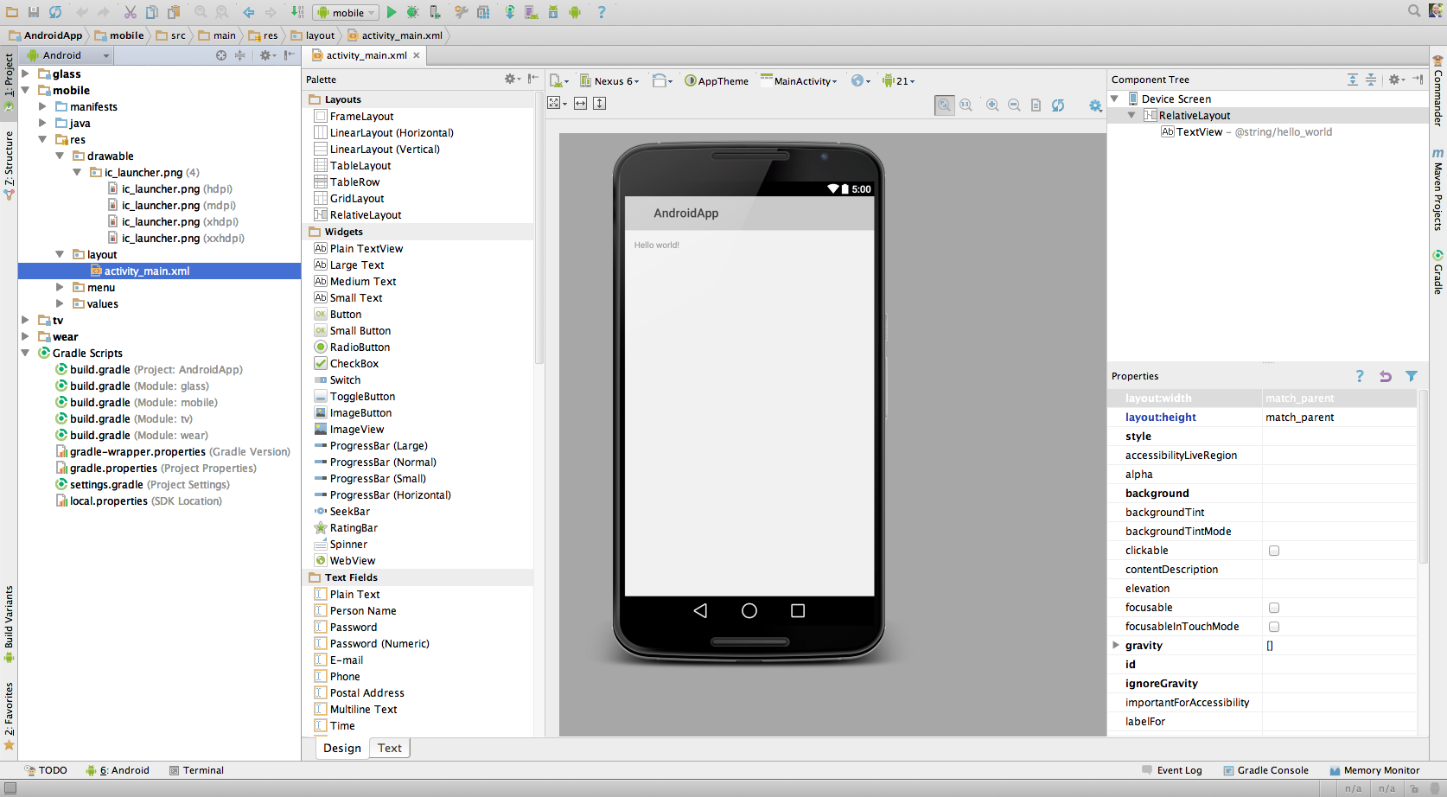
Android Application Fundamentals
Dynamic layout preview – design view

Slide 40
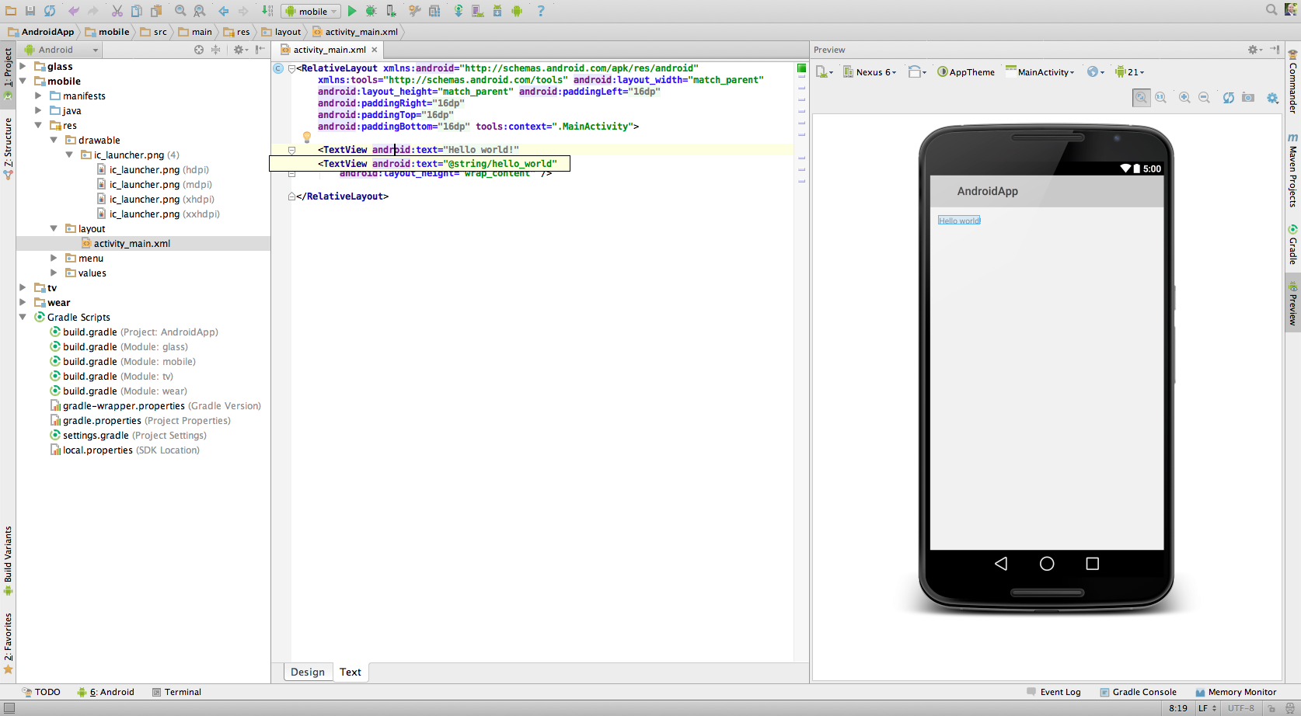
Android Application Fundamentals
Dynamic layout preview – text view

Slide 41
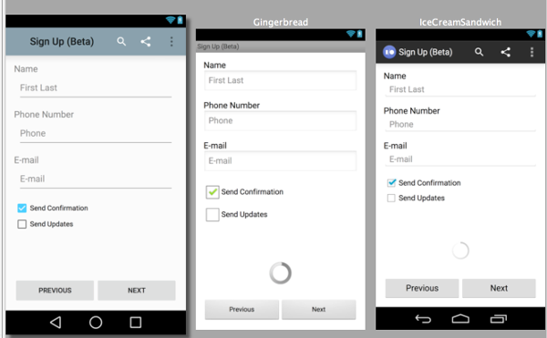
Android Application Fundamentals
Multi-API version rendering

Slide 42
Android Application Fundamentals
Android Application Components
Activities – An Activity is an application component that provides a screen with which users can interact in order to do something, such as dial the phone, take a photo, send an email, or view a map.
Layouts - A layout defines the visual structure for a user interface, such as the UI for an activity or app widget.
Manifest - The manifest file presents essential information about your app to the Android system, information the system must have before it can run any of the app's code.
Resources - Resources are the additional files and static content that your code uses, such as bitmaps, layout definitions, user interface strings, animation instructions, and more.
Intents - An Intent is a messaging object you can use to request an action from another app component.
Services - A Service is an application component that can perform long-running operations in the background and does not provide a user interface.
Content Providers - Content providers manage access to a structured set of data. They encapsulate the data, and provide mechanisms for defining data security.

Slide 43
ACTIVITY

Slide 44
Activity
Activity
An Activity is an application component that provides a screen with which users can interact in order to do something
Each activity is given a window in which to draw its user interface.
The window typically fills the screen, but may be smaller than the screen and float on top of other windows.

Slide 45
Activities
Activity
An application usually consists of multiple activities that are loosely bound to each other
Typically, one activity in an application is specified as the "main" activity, which is presented to the user when launching the application for the first time.
Each activity can then start another activity in order to perform different actions.

Slide 46
Activity
Activity – View & Methods
The Activity class takes care of creating a window for you in which you can place your UI with setContentView(View).
There are two methods almost all subclasses of Activity will implement:
onCreate(Bundle) is where you initialize your activity. Most importantly, here you will usually call setContentView(int) with a layout resource defining your UI, and using findViewById(int) to retrieve the widgets in that UI that you need to interact with programmatically.
onPause() is where you deal with the user leaving your activity. Most importantly, any changes made by the user should at this point be committed (usually to the ContentProvider holding the data).

Slide 47
Activity
Activity - States
An activity has essentially four states:
If an activity in the foreground of the screen (at the top of the stack), it is active or running.
If an activity has lost focus but is still visible (that is, a new non-full-sized or transparent activity has focus on top of your activity), it is paused. A paused activity is completely alive (it maintains all state and member information and remains attached to the window manager), but can be killed by the system in extreme low memory situations.
If an activity is completely obscured by another activity, it is stopped. It still retains all state and member information, however, it is no longer visible to the user so its window is hidden and it will often be killed by the system when memory is needed elsewhere.
If an activity is paused or stopped, the system can drop the activity from memory by either asking it to finish, or simply killing its process. When it is displayed again to the user, it must be completely restarted and restored to its previous state.

Slide 48
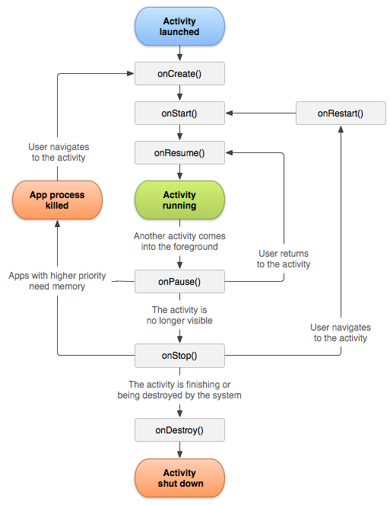
Activity
Activity Lifecycle
The following diagram shows the important state paths of an Activity.
The square rectangles represent callback methods you can implement to perform operations when the Activity moves between states.
The colored ovals are major states the Activity can be in.

Slide 49
Activities
Back Stack
Each time a new activity starts, the previous activity is stopped, but the system preserves the activity in a stack (the "back stack").
When a new activity starts, it is pushed onto the back stack and takes user focus.
The back stack abides to the basic "last in, first out" queue mechanism, so, when the user is done with the current activity and presses the BACK key, it is popped from the stack (and destroyed) and the previous activity resumes.

Slide 50
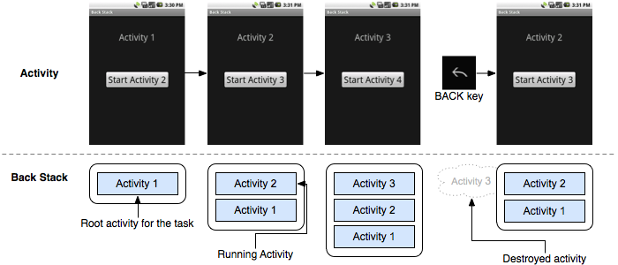
Activities
Back Stack

Slide 51
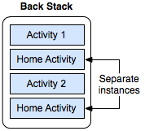
Activities
Back Stack
A single activity is instantiated multiple times

Slide 52
Activities
Creating Activity
Subclass the Activity class
Declare Activity in the manifest (we will cover it in Manifest)
Implement User Interface (we will cover it in User Interface Design)

Slide 53
Activities
Sub class
To create an activity, you must create a subclass of Activity (or an existing subclass of it).
In your subclass, you need to implement callback methods that the system calls when the activity transitions between various states of its lifecycle, such as when the activity is being created, stopped, resumed, or destroyed.

Slide 54
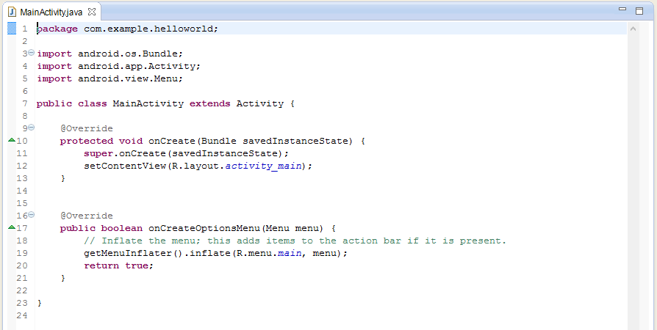
Activity
Activity Example: MainActivity.java (with onCreate() method)

Slide 55
MANIFEST

Slide 56
Android Application Fundamentals
Manifest File
Before the Android system can start an application component, the system must know that the component exists by reading the application's AndroidManifest.xml file (the "manifest" file).
Your application must declare all its components in this file, which must be at the root of the application project directory.
Activities, services, and content providers that you include in your source but do not declare in the manifest are not visible to the system and, consequently, can never run.
Broadcast receivers can be either declared in the manifest or created dynamically in code.

Slide 57
Android Application Fundamentals
Manifest File
The manifest does a number of things in addition to declaring the application's components, such as:
Identify any user permissions the application requires, such as Internet access or read-access to the user's contacts.
Declare the minimum API Level required by the application, based on which APIs the application uses.
Declare hardware and software features used or required by the application, such as a camera, bluetooth services, or a multitouch screen.
API libraries the application needs to be linked against (other than the Android framework APIs), such as the Google Maps library.
And more

Slide 58
Android Application Fundamentals
Declaring components
You must declare all application components this way:
<activity> elements for activities
<service> elements for services
<receiver> elements for broadcast receivers
<provider> elements for content providers

Slide 59
Android Application Fundamentals
Manifest - Uses
Every application must have an AndroidManifest.xml file (with precisely that name) in its root directory. The manifest file presents essential information about your app to the Android system, information the system must have before it can run any of the app's code. Among other things, the manifest does the following:
It names the Java package for the application. The package name serves as a unique identifier for the application.
It describes the components of the application — the activities, services, broadcast receivers, and content providers that the application is composed of. It names the classes that implement each of the components and publishes their capabilities (for example, which Intent messages they can handle). These declarations let the Android system know what the components are and under what conditions they can be launched.
It determines which processes will host application components.
It declares which permissions the application must have in order to access protected parts of the API and interact with other applications.
It also declares the permissions that others are required to have in order to interact with the application's components.
It lists the Instrumentation classes that provide profiling and other information as the application is running. These declarations are present in the manifest only while the application is being developed and tested; they're removed before the application is published.
It declares the minimum level of the Android API that the application requires.
It lists the libraries that the application must be linked against.

Slide 60
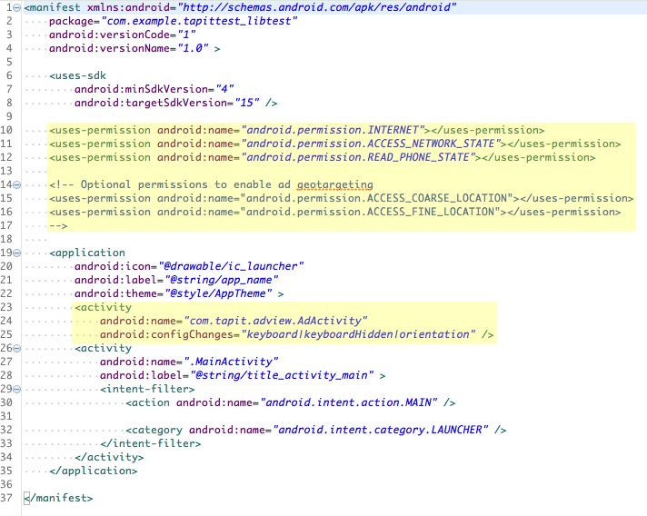
Android Application Fundamentals
Manifest Example: AppManifest.xml (with SDK version, Icon, Launcher)

Slide 61
USER INTERFACE DESIGNING

Slide 62
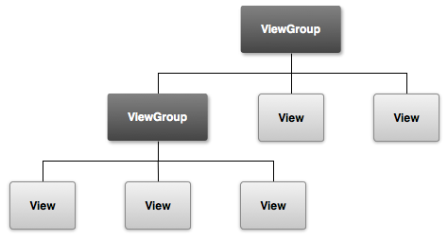
USER INTERFACE DESIGNING
User Interface Design
All user interface elements in an Android app are built using View and ViewGroup objects. A View is an object that draws something on the screen that the user can interact with. A ViewGroup is an object that holds other View (and ViewGroup) objects in order to define the layout of the interface.
Examples of View Group:
Linear Layout, Relative Layout
Examples of View:
Text view, Edit text, Grid view
User interface elements can be defined in an XML file or can be created at runtime

Slide 63


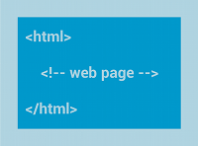
USER INTERFACE DESIGNING
Layouts
A layout is a viewgroup which defines the visual structure for a user interface, such as the UI for an activity or app widget. You can declare a layout in two ways: Declare UI elements in XML or Instantiate layout elements at runtime.
Some Common Layouts: Linear Layout, Relative Layout, Web View
Linear Layout
Relative Layout
Web View
A layout that organizes its children into a single horizontal or vertical row.
Enables you to specify the location of child objects relative to each other (child A to the left of child B) or to the parent (aligned to top of parent)
Displays web pages.

Slide 64
USER INTERFACE DESIGNING
Implement UI
Android provides a number of ready-made views that you can use to design and organize your layout.
"Widgets" are views that provide a visual (and interactive) elements for the screen, such as a button, text field, checkbox, or just an image.
"Layouts" are views derived from ViewGroup that provide a unique layout model for its child views, such as a linear layout, a grid layout, or relative layout.
You can also subclass the View and ViewGroup classes (or existing subclasses) to create your own widgets and layouts and apply them to your activity layout.

Slide 65
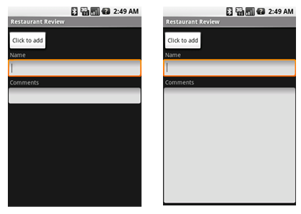
USER INTERFACE DESIGNING
View & View Groups
Views & Widgets
Layout

Slide 66
USER INTERFACE DESIGNING
Define UI
The most common way to define a layout using views is with an XML layout file saved in your application resources.
This way, you can maintain the design of your user interface separately from the source code that defines the activity's behavior.
UI can also be defined at runtime from within the Java source code

Slide 67
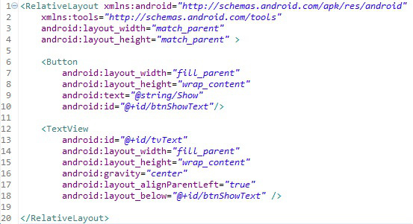
USER INTERFACE DESIGNING
Layout Example: Main.xml (with RelativeLayout, Button & TextView)

Slide 68
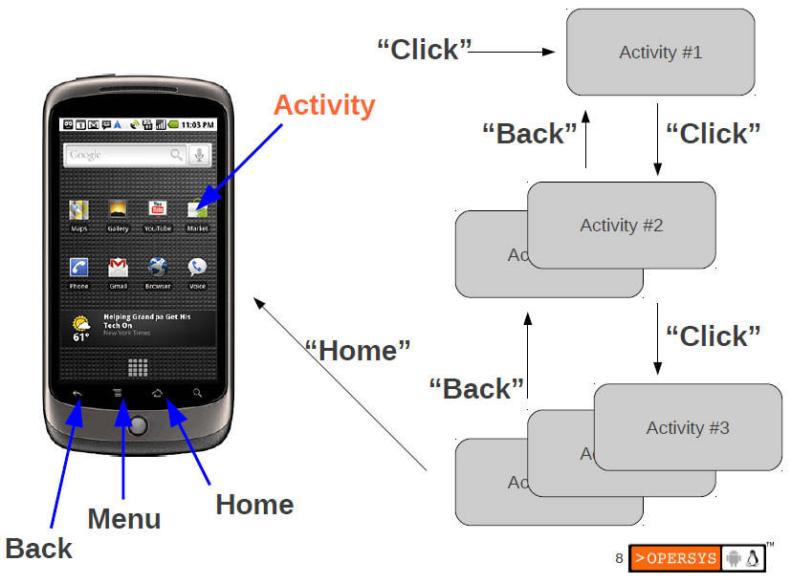
USER INTERFACE DESIGNING
Application - User Interaction

Slide 69
Android Application Fundamentals
Screen Characteristics
Screen size
Screen density
Orientation
Resolution
Density-independent pixel (dp)

Slide 70
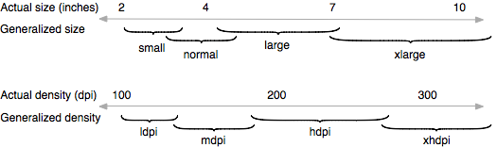
USER INTERFACE DESIGNING
Screen size & Density
Actual physical size, measured as the screen's diagonal.
The quantity of pixels within a physical area of the screen; usually referred to as dpi (dots per inch). For example, a "low" density screen has fewer pixels within a given physical area, compared to a "normal" or "high" density screen.

Slide 71
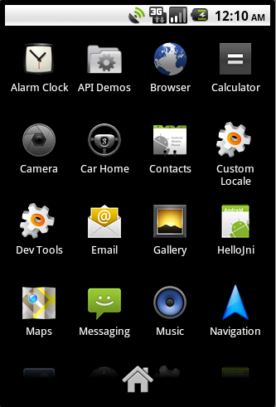
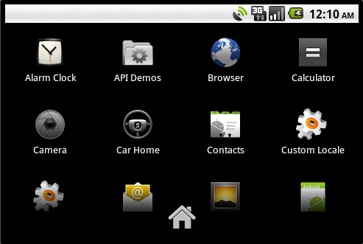
USER INTERFACE DESIGNING
Orientation
Landscape
Portrait

Slide 72
USER INTERFACE DESIGNING
Resolution
The total number of physical pixels on a screen.
When adding support for multiple screens, applications do not work directly with resolution; applications should be concerned only with screen size and density, as specified by the generalized size and density groups.

Slide 73
USER INTERFACE DESIGNING
Density-independent pixel (dp)
A virtual pixel unit that you should use when defining UI layout, to express layout dimensions or position in a density-independent way.
The density-independent pixel is equivalent to one physical pixel on a 160 dpi screen, which is the baseline density assumed by the system for a "medium" density screen.
At runtime, the system transparently handles any scaling of the dp units, as necessary, based on the actual density of the screen in use.
The conversion of dp units to screen pixels is simple: px = dp * (dpi / 160). For example, on a 240 dpi screen, 1 dp equals 1.5 physical pixels.
You should always use dp units when defining your application's UI, to ensure proper display of your UI on screens with different densities.

Slide 74
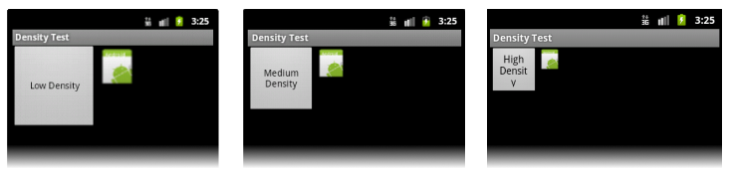
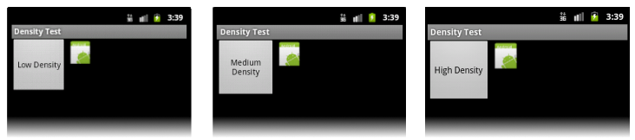
USER INTERFACE DESIGNING
Density Dependence
Example application without support for different densities, as shown on low, medium, and high density screens.
Example application with good support for different densities (it's density independent), as shown on low, medium, and high density screens

Slide 75
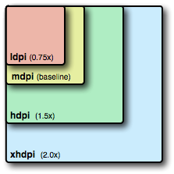
USER INTERFACE DESIGNING
Alternative drawables
36x36 for low-density
48x48 for medium-density
72x72 for high-density
96x96 for extra high-density
3:4:6:8 scaling ratio
res/drawable-mdpi/my_icon.png // bitmap for medium density res/drawable-hdpi/my_icon.png // bitmap for high density res/drawable-xhdpi/my_icon.png // bitmap for extra high density

Slide 76
USER INTERFACE DESIGNING
Screen Configuration
 | Low density (120), ldpi | Medium density (160), mdpi | High density (240), hdpi | Extra high density (320), xhdpi
Small screen | QVGA (240x320) |  | 480x640
Normal screen | WQVGA400 (240x400) WQVGA432 (240x432) | HVGA (320x480) | WVGA800 (480x800) WVGA854 (480x854) 600x1024 | 640x960
Large screen | WVGA800** (480x800) WVGA854** (480x854) | WVGA800* (480x800) WVGA854* (480x854) 600x1024
Extra Large screen | 1024x600 | WXGA (1280x800)† 1024x768 1280x768 | 1536x1152 1920x1152 1920x1200 | 2048x1536 2560x1536 2560x1600
* To emulate this configuration, specify a custom density of 160 when creating an AVD that uses a WVGA800 or WVGA854 skin.

Slide 77
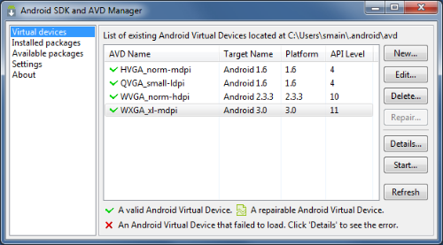
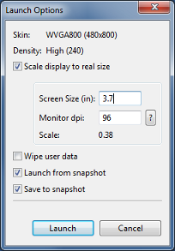
USER INTERFACE DESIGNING
Screen Configuration

Slide 78
INPUT AND EVENT HANDLING

Slide 79
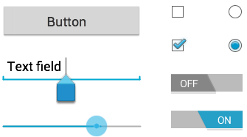
INPUT AND EVENT HANDLING
Input Controls
Input controls are the interactive components in your app's user interface. Android provides a wide variety of controls you can use in your UI, such as buttons, text fields, seek bars, checkboxes, zoom buttons, toggle buttons, and many more.
Button | A push-button that can be pressed, or clicked, by the user to perform an action.
Text field | An editable text field.
Checkbox | An on/off switch that can be toggled by the user. You should use checkboxes when presenting users with a group of selectable options that are not mutually exclusive.
Radio button | Similar to checkboxes, except that only one option can be selected in the group.
Toggle button | An on/off button with a light indicator.
Spinner | A drop-down list that allows users to select one value from a set.

Slide 80
INPUT AND EVENT HANDLING
Input Event Handling
Events are a useful way to collect data about a user's interaction with interactive components of Applications. Like button presses or screen touch etc. The Android framework maintains an event queue as first-in, first-out (FIFO) basis. There are following three concepts related to Android Event Management −
Event Listeners − An event listener is an interface in the View class that contains a single callback method. These methods will be called by the Android framework when the View to which the listener has been registered is triggered by user interaction with the item in the UI. E.g. onClickListener()
Event Listeners Registration − Event Registration is the process by which an Event Handler gets registered with an Event Listener so that the handler is called when the Event Listener fires the event. Events can be registered in the following ways: Use an anonymous Listener class, Use a separate Event Listener class, Using a Layout XML file
Event Handlers − When an event happens and we have registered an event listener for the event, the event listener calls the Event Handlers, which is the method that actually handles the event. E.g. onClick()

Slide 81
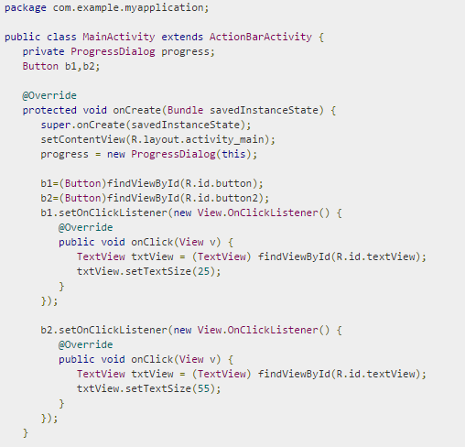
INPUT AND EVENT HANDLING
Example: Event Handling with OnClickListener()

Slide 82
INTENTS

Slide 83
INTENTS
Intent - Uses
You can use an Intent to start activities, services, and broadcast receivers.
Can be done by explicitly naming the target component (using the component class name) in the intent.
However, the real power of intents lies in the concept of intent actions.
With intent actions, you simply describe the type of action you want to perform (and optionally, the data upon which you’d like to perform the action) and allow the system to find a component on the device that can perform the action and start it.
If there are multiple components that can perform the action described by the intent, then the user selects which one to use.

Slide 84
INTENTS
Intents for starting Activity
An intent is an abstract description of an operation to be performed. It can be used with startActivity to launch an Activity, broadcastIntent to send it to any interested BroadcastReceiver components, and startService(Intent)
An Intent provides a facility for performing late runtime binding between the code in different applications. Its most significant use is in the launching of activities, where it can be thought of as the glue between activities. It is basically a passive data structure holding an abstract description of an action to be performed.
The primary pieces of information in an intent are:
Action - The general action to be performed, such as ACTION_VIEW, ACTION_EDIT, ACTION_MAIN, etc.
Data - The data to operate on, such as a person record in the contacts database, expressed as a Uri.
In addition to these primary attributes, there are a number of secondary attributes that you can also include with an intent:
Category -- Gives additional information about the action to execute.
Type -- Specifies an explicit type (a MIME type) of the intent data. Normally the type is inferred from the data itself. By setting this attribute, you disable that evaluation and force an explicit type.
Component -- Specifies an explicit name of a component class to use for the intent.
Extras -- This is a Bundle of any additional information. This can be used to provide extended information to the component. For example, if we have a action to send an e-mail message, we could also include extra pieces of data here to supply a subject, body, etc.

Slide 85
INTENTS
Intent Attributes
The primary pieces of information in an intent are:
Action - The general action to be performed, such as ACTION_VIEW, ACTION_EDIT, ACTION_MAIN, etc.
Data - The data to operate on, such as a person record in the contacts database, expressed as a Uri.
In addition to these primary attributes, there are a number of secondary attributes that you can also include with an intent:
Category -- Gives additional information about the action to execute.
Type -- Specifies an explicit type (a MIME type) of the intent data. Normally the type is inferred from the data itself. By setting this attribute, you disable that evaluation and force an explicit type.
Component -- Specifies an explicit name of a component class to use for the intent.
Extras -- This is a Bundle of any additional information. This can be used to provide extended information to the component. For example, if we have a action to send an e-mail message, we could also include extra pieces of data here to supply a subject, body, etc.

Slide 86
Intents
Three of the core components of an application — activities, services, and broadcast receivers — are activated through messages, called intents.
Intent messaging is a facility for late run-time binding between components in the same or different applications.
The intent itself, an Intent object, is a passive data structure holding an abstract description of an operation to be performed — or, often in the case of broadcasts, a description of something that has happened and is being announced.

Slide 87
Intents
Delivering Intents
There are separate mechanisms for delivering intents to each type of component:
An Intent object is passed to Context.startActivity() or Activity.startActivityForResult() to launch an activity or get an existing activity to do something new. (It can also be passed to Activity.setResult() to return information to the activity that called startActivityForResult().)
An Intent object is passed to Context.startService() to initiate a service or deliver new instructions to an ongoing service. Similarly, an intent can be passed to Context.bindService() to establish a connection between the calling component and a target service. It can optionally initiate the service if it's not already running.
Intent objects passed to any of the broadcast methods (such as Context.sendBroadcast(), Context.sendOrderedBroadcast(), or Context.sendStickyBroadcast()) are delivered to all interested broadcast receivers. Many kinds of broadcasts originate in system code.

Slide 88
Intents
Delivering Intents
In each case, the Android system finds the appropriate activity, service, or set of broadcast receivers to respond to the intent, instantiating them if necessary.
There is no overlap within these messaging systems: Broadcast intents are delivered only to broadcast receivers, never to activities or services.
An intent passed to startActivity() is delivered only to an activity, never to a service or broadcast receiver, and so on.

Slide 89
Intents
Intent Objects
An Intent object is a bundle of information.
It contains information of interest to-
the component that receives the intent (such as the action to be taken and the data to act on)
information of interest to the Android system (such as the category of component that should handle the intent and instructions on how to launch a target activity).

Slide 90
Intents
Intent Objects
Principally, Intent Object can contain the following:
Component name
Action
Data
Category
Extras
Flags

Slide 91
Intents
Component Name
The name of the component that should handle the intent.
This field is a ComponentName object — a combination of –
the fully qualified class name of the target component (for example "com.example.project.app.FreneticActivity") and
the package name set in the manifest file of the application where the component resides (for example, "com.example.project").

Slide 92
Intents
Component Name
The component name is optional.
If it is set, the Intent object is delivered to an instance of the designated class.
If it is not set, Android uses other information in the Intent object to locate a suitable target
The component name is set by setComponent(), setClass(), or setClassName() and read by getComponent().

Slide 93
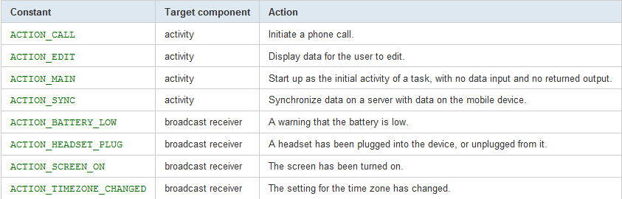
Intents
Action
A string naming the action to be performed — or, in the case of broadcast intents, the action that took place and is being reported
See the Intent class description for a list of pre-defined constants for generic actions.

Slide 94
Intents
Action
You can also define your own action strings for activating the components in your application.
Those you invent should include the application package as a prefix —
for example: "com.example.project.SHOW_COLOR".

Slide 95
Intents
Action
The action largely determines how the rest of the intent is structured — particularly the data and extras fields
The action in an Intent object is set by the setAction() method and read by getAction().

Slide 96
Intents
Data
The URI of the data to be acted on and the MIME type of that data.
Different actions are paired with different kinds of data specifications. For example,
if the action field is ACTION_EDIT, the data field would contain the URI of the document to be displayed for editing.
If the action is ACTION_CALL, the data field would be a tel: URI with the number to call.
if the action is ACTION_VIEW and the data field is an http: URI, the receiving activity would be called upon to download and display whatever data the URI refers to.

Slide 97
Intents
Data
When matching an intent to a component that is capable of handling the data, it's often important to know the type of data (its MIME type) in addition to its URI. For example, a component able to display image data should not be called upon to play an audio file.
The setData() method specifies data only as a URI, setType() specifies it only as a MIME type, and setDataAndType() specifies it as both a URI and a MIME type. The URI is read by getData() and the type by getType().

Slide 98
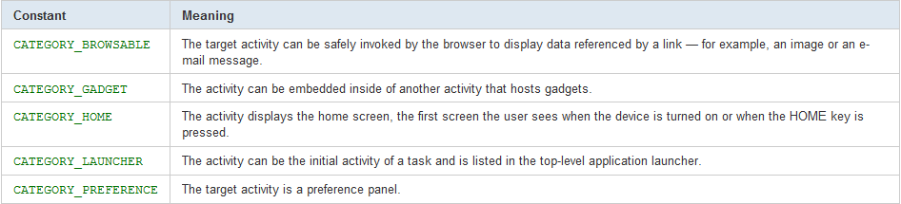
Intents
Category
A string containing additional information about the kind of component that should handle the intent. Any number of category descriptions can be placed in an Intent object.
See the Intent class description for the full list of categories.

Slide 99
Intents
Category
The addCategory() method places a category in an Intent object, removeCategory() deletes a category previously added, and getCategories() gets the set of all categories currently in the object.

Slide 100
Intents
Extras
Key-value pairs for additional information that should be delivered to the component handling the intent.
Just as some actions are paired with particular kinds of data URIs, some are paired with particular extras. For example, an ACTION_TIMEZONE_CHANGED intent has a "time-zone" extra that identifies the new time zone, and ACTION_HEADSET_PLUG has a "state" extra indicating whether the headset is now plugged in or unplugged, as well as a "name" extra for the type of headset.
If you were to invent a SHOW_COLOR action, the color value would be set in an extra key-value pair. The Intent object has a series of put...() methods for inserting various types of extra data and a similar set of get...() methods for reading the data.
the extras can be installed and read as a Bundle using the putExtras() and getExtras() methods.

Slide 101
Intents
Flags
Flags of various sorts.
Many instruct the Android system how to launch an activity (for example, which task the activity should belong to)
how to treat it after it's launched (for example, whether it belongs in the list of recent activities).
All these flags are defined in the Intent class.

Slide 102
Intents
Intent Resolution
Intents can be divided into two groups:
Explicit intents designate the target component by its name. Since component names would generally not be known to developers of other applications, explicit intents are typically used for application-internal messages — such as an activity starting a subordinate service or launching a sister activity.
Android delivers an explicit intent to an instance of the designated target class. Nothing in the Intent object other than the component name matters for determining which component should get the intent.
Implicit intents do not name a target (the field for the component name is blank). Implicit intents are often used to activate components in other applications.

Slide 103
Intents
Implicit Intent Resolution
the Android system must find the best component (or components) to handle the intent —
a single activity or service to perform the requested action
set of broadcast receivers to respond to the broadcast announcement.
It does so by comparing the contents of the Intent object to intent filters, structures associated with components that can potentially receive intents.
Filters advertise the capabilities of a component and delimit the intents it can handle.
They open the component to the possibility of receiving implicit intents of the advertised type.

Slide 104
Intents
Implicit Intent Resolution
Only three aspects of an Intent object are consulted when the object is tested against an intent filter:
action
data (both URI and data type)
category
The extras and flags play no part in resolving which component receives an intent.

Slide 105
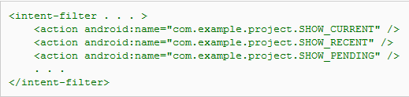
Intents
Action test
To pass this test, the action specified in the Intent object must match one of the actions listed in the filter.
If the object or the filter does not specify an action, the results are as follows:
If the filter fails to list any actions, there is nothing for an intent to match, so all intents fail the test. No intents can get through the filter.
On the other hand, an Intent object that doesn't specify an action automatically passes the test — as long as the filter contains at least one action.

Slide 106
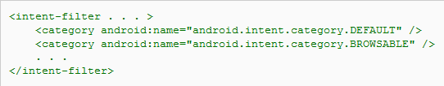
Intents
Category test
For an intent to pass the category test, every category in the Intent object must match a category in the filter.
The filter can list additional categories, but it cannot omit any that are in the intent.
In principle, therefore, an Intent object with no categories should always pass this test, regardless of what's in the filter.

Slide 107

Intents
Data test
Each <data> element can specify a URI and a data type (MIME media type).
There are separate attributes — scheme, host, port, and path — for each part of the URI:
scheme://host:port/path
For example, in the following URI,
content://com.example.project:200/folder/subfolder/etc
host
port
scheme
path
authority

Slide 108
Intents
Data test
When the URI in an Intent object is compared to a URI specification in a filter, it's compared only to the parts of the URI actually mentioned in the filter.
For example-
if a filter specifies only a scheme, all URIs with that scheme match the filter.
If a filter specifies a scheme and an authority but no path, all URIs with the same scheme and authority match, regardless of their paths.
If a filter specifies a scheme, an authority, and a path, only URIs with the same scheme, authority, and path match. However, a path specification in the filter can contain wildcards to require only a partial match of the path.

Slide 109
Intents
Data test
The type attribute of a <data> element specifies the MIME type of the data.
It's more common in filters than a URI.
Both the Intent object and the filter can use a "*" wildcard for the subtype field — for example, "text/*" or "audio/*" — indicating any subtype matches.
The data test compares both the URI and the data type in the Intent object to a URI and data type specified in the filter.

Slide 110
Intents
Data test
The rules are as follows:
An Intent object that contains neither a URI nor a data type passes the test only if the filter likewise does not specify any URIs or data types.
An Intent object that contains a URI but no data type (and a type cannot be inferred from the URI) passes the test only if its URI matches a URI in the filter and the filter likewise does not specify a type. This will be the case only for URIs like mailto: and tel: that do not refer to actual data.
An Intent object that contains a data type but not a URI passes the test only if the filter lists the same data type and similarly does not specify a URI.
An Intent object that contains both a URI and a data type (or a data type can be inferred from the URI) passes the data type part of the test only if its type matches a type listed in the filter. It passes the URI part of the test either if its URI matches a URI in the filter or if it has a content: or file: URI and the filter does not specify a URI. In other words, a component is presumed to support content: and file: data if its filter lists only a data type.

Slide 111

INTENTS
Start Activity with Intent
The following code demonstrates how you can start another activity via an intent.
Start Service with Intent

Slide 112
INTENTS
Types of Intent
Implicit Intents
Implicit intents specify the action which should be performed and optionally data which provides content for the action.
For example, the following tells the Android system to view a webpage. Explicit intents explicitly define the component which should be called by the Android system, by using the Java class as identifier.

Slide 113
INTENTS
Types of Intent
Explicit Intents
Explicit intents explicitly define the component which should be called by the Android system, by using the Java class as identifier.
The following shows how to create an explicit intent and send it to the Android system. If the class specified in the intent represents an activity, the Android system starts it.

Slide 114

INTENTS
Starting an Activity with Intent and setting a value in TextView
Passing a value to the Activity
Receiving the value & setting it in a TextView

Slide 115

INTENTS
Intent Filters
Intents are used to signal to the Android system that a certain event has occurred. Intents often describe the action which should be performed and provide data upon which such an action should be done.
For example, your application can start a browser component for a certain URL via an intent. This is demonstrated by the following example.
But how does the Android system identify the components which can react to a certain intent?
A component can register itself via an intent filter for a specific action and specific data.
Android components register intent filters either statically in the AndroidManifest.xml or in case of a broadcast receiver also dynamically via code. An intent filter is defined by its category, action and data filters. It can also contain additional meta-data.

Slide 116

INTENTS
Defining Intent Filters
You can register your Android components via intent filters for certain events. If a component does not define one, it can only be called by explicit intents.
The following code will register an Activity for the Intent which is triggered when someone wants to open a webpage.

Slide 117
LISTVIEW

Slide 118

LISTVIEW
ListView
ListView is a view group that displays a list of scrollable items. The list items are automatically inserted to the list using an Adapter that pulls content from a source such as an array or database query and converts each item result into a view that's placed into the list.
Adding a ListView in the XML layout
Using an Array Adapter to fill data in a ListView

Slide 119
LISTVIEW
Adapters
Sometimes you'll want to populate a view group with some information that can't be hard-coded, instead, you want to bind your view to an external source of data.
To do this, you use an AdapterView as your view group and each child View is initialized and populated with data from the Adapter.

Slide 120
LISTVIEW
AdapterView
Gallery, ListView, and Spinner are examples of AdapterView subclasses that you can use to bind to a specific type of data and display it in a certain way.
AdapterView objects have two main responsibilities:
Filling the layout with data
Handling user selections

Slide 121

LISTVIEW
SimpleCursorAdapter

Slide 122
User Interface
SimpleCursorAdapter
SimpleCursorAdapter(Context context, int layout, Cursor c, String[] from, int[] to)
This adapter converts a row in the cursor to a child view for the container control. The definition of the child view is defined in an XML resource (layout parameter).
A row in the cursor might have many columns, you tell the SimpleCursorAdapter which columns you want to select from the row by specifying an array of column names (using the from parameter).
Similarly, because each column you select is mapped to a TextView, you must specify the IDs in the to parameter. There’s a one-to-one mapping between the column that you select and a TextView that displays the data in the column, so the from and to parameters must be the same size.

Slide 123
LISTVIEW
ArrayAdapter
ArrayAdapter<String> adapter = new ArrayAdapter<String>(this,android.R.layout.simple_list_item_1,new string[]{"sayed","satya"});
code creates an ArrayAdapter where the TextView controls’ data is represented by strings.
android.R.layout.simple_list_item_1 points to a TextView defined by the Android SDK.

Slide 124


LISTVIEW
ListView
Using a Simple Cursor Adapter to fill data in a ListView
Use this adapter when your data comes from a Cursor. When using SimpleCursorAdapter, you must specify a layout to use for each row in the Cursor and which columns in the Cursor should be inserted into which views of the layout. For example, if you want to create a list of people's names and phone numbers, you can perform a query that returns a Cursor containing a row for each person and columns for the names and numbers. You then create a string array specifying which columns from the Cursoryou want in the layout for each result and an integer array specifying the corresponding views that each column should be placed:

Slide 125

LISTVIEW
ListView
Handling Click Events
You can respond to click events on each item in an AdapterView by implementing the AdapterView.OnItemClickListener interface. For example:

Slide 126
LISTACTIVITY

Slide 127
LISTACTIVITY
In the contextual action mode. This mode is a system implementation of ActionMode that displays a contextual action bar at the top of the screen with action items that affect the selected item(s). When this mode is active, users can perform an action on multiple items at once (if your app allows it).
ListActivity
A ListActivity is an activity that displays a list of items by binding to a data source such as an array or Cursor, and exposes event handlers when the user selects an item.
ListActivity Layout hosts a ListView object that can be bound to different data sources, typically either an array or a Cursor holding query results. Binding, screen layout, and row layout are discussed in the following sections.
In ListActivity – Row Layout we specify the layout of individual rows in the list. We do this by specifying a layout resource in the ListAdapter object hosted by the activity (the ListAdapter binds the ListView to the data). The layout XML is the source for the resource two_line_list_item, which displays two data fields,one above the other, for each list row.
The code in List Activity – Data Binding demonstrates querying the Contacts provider for all contacts, then binding the Name and Company fields to a two line row layout in the activity's ListView.

Slide 128

LISTACTIVITY
In the contextual action mode. This mode is a system implementation of ActionMode that displays a contextual action bar at the top of the screen with action items that affect the selected item(s). When this mode is active, users can perform an action on multiple items at once (if your app allows it).
ListActivity Layout

Slide 129

LISTACTIVITY
ListActivity – Row Layout

Slide 130

LISTACTIVITY
ListActivity – Data Binding

Slide 131
DIALOGS

Slide 132
User Interface
Dialogs
The Dialog class is the base class for creating dialogs. However, you typically should not instantiate a Dialog directly. Instead, you should use one of the following subclasses:
AlertDialog A dialog that can manage zero, one, two, or three buttons, and/or a list of selectable items that can include checkboxes or radio buttons. The AlertDialog is capable of constructing most dialog user interfaces and is the suggested dialog type.
ProgressDialog A dialog that displays a progress wheel or progress bar. Because it's an extension of the AlertDialog, it also supports buttons.
DatePickerDialog A dialog that allows the user to select a date. See the Hello DatePicker tutorial. TimePickerDialog A dialog that allows the user to select a time.

Slide 133

User Interface
Creating a ProgressDialog
A ProgressDialog is an extension of the AlertDialog class that can display a progress animation in the form of a spinning wheel, for a task with progress that's undefined, or a progress bar, for a task that has a defined progression.
The dialog can also provide buttons, such as one to cancel a download.
Opening a progress dialog can be as simple as calling ProgressDialog.show().
ProgressDialog dialog = ProgressDialog.show(MyActivity.this, "", "Loading. Please wait...", true);
The first parameter is the application Context, the second is a title for the dialog (left empty), the third is the message, and the last parameter is whether the progress is indeterminate

Slide 134

User Interface
Showing a progress bar
To show the progression with an animated progress bar:
Initialize the ProgressDialog with the class constructor, ProgressDialog(Context).
Set the progress style to "STYLE_HORIZONTAL" with setProgressStyle(int) and set any other properties, such as the message.
When you're ready to show the dialog, call show() or return the ProgressDialog from the onCreateDialog(int) callback.
You can increment the amount of progress displayed in the bar by calling either setProgress(int) with a value for the total percentage completed so far or incrementProgressBy(int) with an incremental value to add to the total percentage completed so far.

Slide 135

DIALOGS
User Input Dialogs
A dialog is a small window that prompts the user to make a decision or enter additional information. A dialog does not fill the screen and is normally used for modal events that require users to take an action before they can proceed.
Type of User Input Dialogs
Alert Dialog
A dialog that can show a title, up to three buttons, a list of selectable items, or a custom layout.
Date Picker or Time Picker Dialog
A dialog with a pre-defined UI that allows the user to select a date or time.

Slide 136


DIALOGS
Dialogs – Alert Dialog
Below is a basic Alert dialog managed within a dialog fragment.

Slide 137


DIALOGS
Dialogs – Time Picker
Below is a Time Picker dialog managed within a dialog fragment.

Slide 138


DIALOGS
Dialogs – Showing the Dialog
Once we have defined a DialogFragment, we can display the dialog by creating an instance of the DialogFragment and calling show().
For example, here's a button that, when clicked, calls a method to show the Time Picker dialog:
When the user clicks this button, the system calls the following method:

Slide 139
MENUS

Slide 140
MENUS
Menus
Menus reveals application functions and settings.
The most common application menu is revealed by pressing the MENU key on the device.
However, you can also add Context Menus, which may be revealed when the user presses and holds down on an item.

Slide 141

User Interface
Menus

Slide 142


MENUS
Options Menu and Action Bar
The options menu is the primary collection of menu items for an activity. It's where you should place actions that have a global impact on the app, such as "Search," "Compose email," and "Settings.“
For Android 2.3 or lower, users can reveal the options menu panel by pressing the Menu button.
Beginning with Android 3.0, the Menu button is deprecated (some devices don't have one), so you should migrate toward using the action bar to provide access to actions and other options.

Slide 143

MENUS
Menus
Contextual Menu
A contextual menu offers actions that affect a specific item or context frame in the UI. You can provide a context menu for any view, but they are most often used for items in a ListView,GridView, or other view collections in which the user can perform direct actions on each item.
In the contextual action mode the menu displays a contextual action bar at the top of the screen with action items that affect the selected item(s). When this mode is active, users can perform an action on multiple items at once (if your app allows it).
In a floating context menu. A menu appears as a floating list of menu items

Slide 144
MENUS
Creating a Menu Resource
Instead of instantiating a Menu in your application code, you should define a menu and all its items in an XML menu resource, then inflate the menu resource (load it as a programmable object) in your application code.
Using a menu resource to define your menu is a good practice because it separates the content for the menu from your application code.
It's also easier to visualize the structure and content of a menu in XML.

Slide 145

MENUS
Creating a Menu Resource

Slide 146
MENUS
Creating a Menu Resource
To create a menu resource, create an XML file inside your project's res/menu/ directory and build the menu with the following elements:
<menu> Defines a Menu, which is a container for menu items. A <menu> element must be the root node for the file and can hold one or more <item> and <group> elements.
<item> Creates a MenuItem, which represents a single item in a menu. This element may contain a nested <menu> element in order to create a submenu.
<group> An optional, invisible container for <item> elements. It allows you to categorize menu items so they share properties such as active state and visibility.

Slide 147

MENUS
Inflating a Menu Resource
From your application code, you can inflate a menu resource (convert the XML resource into a programmable object) using MenuInflater.inflate().

Slide 148
MENUS
Creating an Options Menu
The Options Menu is where you should include basic activity actions and necessary navigation items
the Options Menu appears at the bottom of the screen
When opened, the first visible portion of the Options Menu is the icon menu. It holds the first six menu items.
If you add more than six items to the Options Menu, Android places the sixth item and those after it into the overflow menu, which the user can open by touching the "More" menu item.

Slide 149

MENUS
Creating an Options Menu
When the Android system creates the Options Menu for the first time, it calls your activity's onCreateOptionsMenu() method.
Override this method in your activity and populate the Menu that is passed into the method, Menu by inflating a menu

Slide 150

MENUS
Responding to user action
When the user selects a menu item from the Options Menu
the system calls your activity's onOptionsItemSelected() method. This method passes the MenuItem that the user selected. You can identify the menu item by calling getItemId(), which returns the unique ID for the menu item (defined by the android:id attribute in the menu resource).
You can match this ID against known menu items and perform the appropriate action.

Slide 151

MENUS
Creating a Context Menu
A context menu is conceptually similar to the menu displayed when the user performs a "right-click" on a PC.
You should use a context menu to provide the user access to actions that pertain to a specific item in the user interface.
On Android, a context menu is displayed when the user performs a "long press" (press and hold) on an item.

Slide 152


MENUS
Creating a Context Menu
In order for a View to provide a context menu, you must "register" the view for a context menu. Call registerForContextMenu() and pass it the View you want to give a context menu. When this View then receives a long-press, it displays a context menu.
To define the context menu's appearance and behavior, override your activity's context menu callback methods, onCreateContextMenu() and onContextItemSelected().

Slide 153

User Interface
Creating Submenus
A submenu is a menu that the user can open by selecting an item in another menu.
You can add a submenu to any menu (except a submenu).
Submenus are useful when your application has a lot of functions that can be organized into topics, like items in a PC application's menu bar (File, Edit, View, etc.).

Slide 154

MENUS
Creating Submenus
When creating your menu resource, you can create a submenu by adding a <menu> element as the child of an <item>.

Slide 155
MENUS
Responding to user action
When the user selects an item from a submenu, the parent menu's respective on-item-selected callback method receives the event.
For instance, if the above menu is applied as an Options Menu, then the onOptionsItemSelected() method is called when a submenu item is selected.

Slide 156
WEBVIEWS

Slide 157

WEBVIEWS
WebViews
WebViews can deliver a web application experience (or just a web page) as a part of a client application. It does not include any features of a fully developed web browser, such as navigation controls or an address bar.
A common scenario in which using WebView is helpful is when you want to provide information in your application that you might need to update, such as an end-user agreement or a user guide.
We can also use webviews to capture URLs from a user and redirect the user to the webpage on the performing of a certain event e.g. clicking a button.

Slide 158


WEBVIEWS
Adding a WebView
To add a WebView to your Application, simply include the <WebView> element in your activity layout. For example, here's a layout file in which the WebView fills the screen:
To load a web page in the WebView, use loadUrl(). For example:
Before this will work, however, your application must have access to the Internet. To get Internet access, request the INTERNET permission in your manifest file. For example:

Slide 159

WEBVIEWS
WebView - Enable JavaScript via Settings
JavaScript is disabled in a WebView by default. You can enable it through the WebSettings attached to yourWebView. You can retrieve WebSettings with getSettings(), then enable JavaScript with setJavaScriptEnabled().

Slide 160
WEBVIEWS
WebView – Opening Links in the WebView
When the user clicks a link from a web page in your WebView, the default behavior is for Android to launch an application that handles URLs.
Usually, the default web browser opens and loads the destination URL. However, you can override this behavior for your WebView, so links open within your WebView. You can then allow the user to navigate backward and forward through their web page history that's maintained by your WebView.
To open links clicked by the user, simply provide a WebViewClient for your WebView, usingsetWebViewClient(). For example:
That's it. Now all links the user clicks load in your WebView.

Slide 161

WEBVIEWS
WebView – Handling Navigation
When your WebView overrides URL loading, it automatically accumulates a history of visited web pages. You can navigate backward and forward through the history with goBack() and goForward().
For example, here's how your Activity can use the device Back button to navigate backward:
The canGoBack() method returns true if there is actually web page history for the user to visit. Likewise, you can use canGoForward() to check whether there is a forward history. If you don't perform this check, then once the user reaches the end of the history, goBack() or goForward() does nothing.

Slide 162
DATA STORAGE IN FILES

Slide 163
Data Storage
Internal Storage
You can save files directly on the device's internal storage.
By default, files saved to the internal storage are private to your application and other applications cannot access them (nor can the user).
When the user uninstalls your application, these files are removed.

Slide 164
Data Storage
Using the Internal Storage
To create and write a private file to the internal storage
Call openFileOutput() with the name of the file and the operating mode. This returns a FileOutputStream.
Write to the file with write().
Close the stream with close().

Slide 165

Data Storage
Using the Internal Storage
MODE_PRIVATE will create the file (or replace a file of the same name) and make it private to your application.
MODE_APPEND Append to a file
MODE_WORLD_READABLE World Readable
MODE_WORLD_WRITEABLE World readable/writable

Slide 166
Data Storage
Using the Internal Storage
To read a file from internal storage:
Call openFileInput() and pass it the name of the file to read. This returns a FileInputStream.
Read bytes from the file with read().
Then close the stream with close().

Slide 167
Data Storage
Using the External Storage
Every Android-compatible device supports a shared "external storage" that you can use to save files.
This can be a removable storage media (such as an SD card) or an internal (non-removable) storage.
Files saved to the external storage are world-readable and can be modified by the user when they enable USB mass storage to transfer files on a computer.

Slide 168

Data Storage
Checking media availability

Slide 169
Data Storage
Accessing files on external storage
use getExternalFilesDir() to open a File that represents the external storage directory where you should save your files.
This method takes a type parameter that specifies the type of subdirectory you want, such as DIRECTORY_MUSIC and DIRECTORY_RINGTONES (pass null to receive the root of your application's file directory).
This method will create the appropriate directory if necessary.
By specifying the type of directory, you ensure that the Android's media scanner will properly categorize your files in the system (for example, ringtones are identified as ringtones and not music).
If the user uninstalls your application, this directory and all its contents will be deleted.

Slide 170
Data Storage
Saving files that should be shared
If you want to save files that are not specific to your application and that should not be deleted when your application is uninstalled, save them to one of the public directories on the external storage.
These directories lay at the root of the external storage, such as Music/, Pictures/, Ringtones/, and others.

Slide 171
Data Storage
Saving files that should be shared
Music/ - Media scanner classifies all media found here as user music.
Podcasts/ - Media scanner classifies all media found here as a podcast.
Ringtones/ - Media scanner classifies all media found here as a ringtone.
Alarms/ - Media scanner classifies all media found here as an alarm sound.
Notifications/ - Media scanner classifies all media found here as a notification sound.
Pictures/ - All photos (excluding those taken with the camera).
Movies/ - All movies (excluding those taken with the camcorder).
Download/ - Miscellaneous downloads.

Slide 172
DATA STORAGE IN FILES
Data Storage in Files
Android uses a file system that's similar to disk-based file systems on other platforms. This lesson describes how to work with the Android file system to read and write files with the File APIs.
Choose Internal or External Storage
All Android devices have two file storage areas: "internal" and "external" storage.
Most devices offer built-in non-volatile memory (internal storage), plus a removable storage medium such as a micro SD card (external storage).
Some devices divide the permanent storage space into "internal" and "external" partitions, so even without a removable storage medium, there are always two storage spaces and the API behavior is the same whether the external storage is removable or not.

Slide 173

DATA STORAGE IN FILES
Data Storage in Internal Memory Files
When saving a file to internal storage, you can acquire the appropriate directory as a File by calling one of two methods:
getFilesDir(): Returns a File representing an internal directory for your app.
getCacheDir(): Returns a File representing an internal directory for your app's temporary cache files.
To create a new file in one of these directories, you can use the File() constructor, passing the File provided by one of the above methods that specifies your internal storage directory.

Slide 174


DATA STORAGE IN FILES
Data Storage in External Memory Files
Obtain Permissions for External Storage
To write to the external storage, you must request the WRITE_EXTERNAL_STORAGE permission in your manifest file:

Slide 175

DATA STORAGE IN FILES
Data Storage in External Memory Files
Check if external storage is available for Read & Write
Because the external storage may be unavailable you should always verify that the volume is available before accessing it. You can query the external storage state by calling getExternalStorageState(). If the returned state is equal to MEDIA_MOUNTED, then you can read and write your files.

Slide 176

DATA STORAGE IN FILES
Data Storage in External Memory Files
Create a file and write data
Create a text file in the external memory and write data

Slide 177
SHARED PREFERENCES

Slide 178
SHARED PREFERENCES
Shared Preferences
The SharedPreferences class provides a general framework that allows you to save and retrieve persistent key-value pairs of primitive data types.
You can use SharedPreferences to save any primitive data: booleans, floats, ints, longs, and strings.
This data will persist across user sessions (even if your application is killed).

Slide 179
SHARED PREFERENCES
Using Shared Preferences
To get a SharedPreferences object for your application, use one of two methods:
getSharedPreferences() - Use this if you need multiple preferences files identified by name, which you specify with the first parameter.
getPreferences() - Use this if you need only one preferences file for your Activity. Because this will be the only preferences file for your Activity, you don't supply a name.

Slide 180
SHARED PREFERENCES
Using Shared Preferences
To write values:
Call edit() to get a SharedPreferences.Editor.
Add values with methods such as putBoolean() and putString().
Commit the new values with commit()
To read values, use SharedPreferences methods such as getBoolean() and getString().

Slide 181

SHARED PREFERENCES
Using Shared Preferences
Shared Preference
file name
Restore data
in your code
Get Shared Preference
Each getter takes a key and a default value
(used when no value has yet been saved
for that key)
Read your data
Save data

Slide 182
SQLITE

Slide 183
SQLITE
SQLite Database
Android provides full support for SQLite databases.
Any databases you create will be accessible by name to any class in the application, but not outside the application.
Saving data to a database is ideal for repeating or structured data, such as contact information.
Just like files that you save on the device's internal storage, Android stores your database in private disk space that's associated application. Your data is secure, because by default this area is not accessible to other applications.

Slide 184
SQLITE
SQLite Database
You can then get an instance of your SQLiteOpenHelper implementation using the constructor you've defined.
To write to and read from the database, call getWritableDatabase() and getReadableDatabase(), respectively. These both return a SQLiteDatabase object that represents the database and provides methods for SQLite operations.
You can execute SQLite queries using the SQLiteDatabase query() methods, which accept various query parameters, such as the table to query, the projection, selection, columns, grouping, and others.
For complex queries, such as those that require column aliases, you should use SQLiteQueryBuilder, which provides several convenient methods for building queries.
Every SQLite query will return a Cursor that points to all the rows found by the query. The Cursor is always the mechanism with which you can navigate results from a database query and read rows and columns.

Slide 185
SQLITE
Using the SQLite Database
In order to utilize the SQLite DB we need to follow the below steps:
Create the Database Schema & Contract
Create the SQLite Helper and data manipulation methods that we require
Call the data manipulation methods (select, insert, update or delete) from the Helper or Activity

Slide 186

SQLITE
Create the DB Schema & Contract
A contract class is a container for constants that define names for tables and columns. This lets you change a column name in one place and have it propagate throughout your code.

Slide 187

SQLITE
Create the SQLite Helper
The SQLite Helper Class is used to implement methods that create and maintain the database. To use the SQLiteOpenHelper, create a subclass that overrides the onCreate(), onUpgrade() and onOpen() callback methods.

Slide 188

SQLITE
Put Information into a Database
Insert data into the database by passing a ContentValues object to the insert() method:

Slide 189

SQLITE
Read Information from a Database
To read from a database, use the query() method, passing it your selection criteria and desired columns. The results of the query are returned to you in a Cursor object.

Slide 190

SQLITE
Look at a row in the cursor
Generally, you should start by calling moveToFirst(), which places the "read position" on the first entry in the results.
For each row, you can read a column's value by calling one of the Cursor get methods, such as getString() or getLong().
For each of the get methods, you must pass the index position of the column you desire, which you can get by calling getColumnIndex() or getColumnIndexOrThrow().

Slide 191

SQLITE
Delete Information from a Database
To delete rows from a table, you need to provide selection criteria that identify the rows.

Slide 192

SQLITE
Update a Database
When you need to modify a subset of your database values, use the update() method.

Slide 193
NOTIFICATIONS

Slide 194
NOTIFICATIONS
User Notification
User different technique:
A Toast Notification, for brief messages that come from the background.
A Status Bar Notification, for persistent reminders that come from the background and request the user's response.
A Dialog Notification, for Activity-related notifications.

Slide 195

NOTIFICATIONS
Creating Toast Notifications
A toast notification is a message that pops up on the surface of the window.
It only fills the amount of space required for the message and the user's current activity remains visible and interactive.
The notification automatically fades in and out, and does not accept interaction events.
A toast can be created and displayed from an Activity or Service. If you create a toast notification from a Service, it appears in front of the Activity currently in focus.

Slide 196

NOTIFICATIONS
Creating Toast Notifications
You can also chain your methods and avoid holding on to the Toast object, like this:

Slide 197

NOTIFICATIONS
Status Bar Notifications

Slide 198
NOTIFICATIONS
Status Bar Notifications
A status bar notification adds an icon to the system's status bar (with an optional ticker-text message) and an expanded message in the "Notifications" window.
When the user selects the expanded message, Android fires an Intent that is defined by the notification (usually to launch an Activity).
You can also configure the notification to alert the user with a sound, a vibration, and flashing lights on the device.

Slide 199
NOTIFICATIONS
Status Bar Notifications
A status bar notification should be used for any case in which a background Service needs to alert the user about an event that requires a response.
A background Service should never launch an Activity on its own in order to receive user interaction.
The Service should instead create a status bar notification that will launch the Activity when selected by the user.

Slide 200
NOTIFICATIONS
Creating Status Bar Notifications
Get a reference to the NotificationManager:

Slide 201

NOTIFICATIONS
Creating Status Bar Notifications
Instantiate the Notification:

Slide 202

NOTIFICATIONS
Creating Status Bar Notifications
Define the Notification's expanded message and Intent:

Slide 203

NOTIFICATIONS
Creating Status Bar Notifications
Pass the Notification to the NotificationManager:

Slide 204
NOTIFICATIONS
Adding Sound, vibration etc
notification.defaults |= Notification.DEFAULT_SOUND;
notification.defaults |= Notification.DEFAULT_VIBRATE;
notification.defaults |= Notification.DEFAULT_LIGHTS;

Slide 205
ANDROID RESOURCES

Slide 206
Application Resources
You should always externalize resources such as images and strings from your application code, so that you can maintain them independently.
Externalizing your resources also allows you to provide alternative resources that support specific device configurations such as different languages or screen sizes, which becomes increasingly important as more
Android-powered devices become available with different configurations. In order to provide compatibility with different configurations, you must organize resources in your project's res/ directory, using various sub-directories that group resources by type and configuration.

Slide 207


Application Resources
Two different devices, both using default resources
Two different devices, one using alternative resources

Slide 208
Application Resources
Providing Resources
Directory | Resource Type
animator/ | XML files that define property animations.
anim/ | XML files that define tween animations. (Property animations can also be saved in this directory, but the animator/ directory is preferred for property animations to distinguish between the two types.)
color/ | XML files that define a state list of colors. See Color State List Resource

Slide 209
Application Resources
Providing Resources
drawable/ | Bitmap files (.png, .9.png, .jpg, .gif) or XML files that are compiled into the following drawable resource subtypes: Bitmap files Nine-Patches (re-sizable bitmaps) State lists Shapes Animation drawables Other drawables

Slide 210
Application Resources
Providing Resources
layout/ | XML files that define a user interface layout. See Layout Resource.
menu/ | XML files that define application menus, such as an Options Menu, Context Menu, or Sub Menu. See Menu Resource.
raw/ | Arbitrary files to save in their raw form. To open these resources with a raw InputStream, call Resources.openRawResource() with the resource ID, which is R.raw.filename. However, if you need access to original file names and file hierarchy, you might consider saving some resources in the assets/ directory (instead of res/raw/). Files in assets/ are not given a resource ID, so you can read them only using AssetManager.

Slide 211
Application Resources
Providing Resources
values/ | XML files that contain simple values, such as strings, integers, and colors. arrays.xml for resource arrays (typed arrays). colors.xml for color values dimens.xml for dimension values. strings.xml for string values. styles.xml for styles.
xml/ | Arbitrary XML files that can be read at runtime by calling Resources.getXML(). Various XML configuration files must be saved here, such as a searchable configuration.

Slide 212
Application Resources
Providing Alternative Resources
Screen orientation port land
Screen pixel density (dpi)
ldpi mdpi hdpi xhdpi nodpi
Screen size
small normal large xlarge
Screen aspect
long notlong

Slide 213
Application Resources
Accessing Resources
When your application is compiled, aapt generates the R class, which contains resource IDs for all the resources in your res/ directory.
Although the R class is where resource IDs are specified, you should never need to look there to discover a resource ID. A resource ID is always composed of:
The resource type: Each resource is grouped into a "type," such as string, drawable, and layout.
The resource name, which is either: the filename, excluding the extension; or the value in the XML

Slide 214
Application Resources
Accessing Resources
There are two ways you can access a resource:
In code: Using an static integer from a sub-class of your R class, such as: R.string.hello string is the resource type and hello is the resource name. There are many Android APIs that can access your resources when you provide a resource ID in this format.
In XML: Using a special XML syntax that also corresponds to the resource ID defined in your R class, such as: @string/hello string is the resource type and hello is the resource name. You can use this syntax in an XML resource any place where a value is expected that you provide in a resource.

Slide 215
Application Resources
Accessing Resources in Code
Here's the syntax to reference a resource in code:
[<package_name>.]R.<resource_type>.<resource_name>
<package_name> is the name of the package in which the resource is located (not required when referencing resources from your own package).
<resource_type> is the R subclass for the resource type.
<resource_name> is either the resource filename without the extension or the android:name attribute value in the XML element (for simple values).

Slide 216

Application Resources
Use cases

Slide 217
Application Resources
Accessing Resources from XML
Here is the syntax to reference a resource in an XML resource:
@[<package_name>:]<resource_type>/<resource_name>
<package_name> is the name of the package in which the resource is located (not required when referencing resources from the same package)
<resource_type> is the R subclass for the resource type
<resource_name> is either the resource filename without the extension or the android:name attribute value in the XML element (for simple values).

Slide 218


Application Resources
Use Cases

Slide 219
STYLES & THEMES

Slide 220
STYLES & THEMES
Styles and Themes
Perhaps you're not satisfied with the look of the standard widgets. To revise them, you can create some of your own styles and themes.
A style is a set of one or more formatting attributes that you can apply as a unit to individual elements in your layout. For example, you could define a style that specifies a certain text size and color, then apply it to only specific View elements.
A theme is a set of one or more formatting attributes that you can apply as a unit to all activities in an application, or just a single activity. For example, you could define a theme that sets specific colors for the window frame and the panel background, and sets text sizes and colors for menus. This theme can then be applied to specific activities or the entire application.

Slide 221
STYLES & THEMES
Styles and Themes
A style is a collection of properties that specify the look and format for a View or window. A style can specify properties such as height, padding, font color, font size, background color, and much more. A style is defined in an XML resource that is separate from the XML that specifies the layout.
Styles in Android share a similar philosophy to cascading stylesheets in web design—they allow you to separate the design from the content.

Slide 222


STYLES & THEMES
Style

Slide 223

STYLES & THEMES
Defining Style
To create a set of styles, save an XML file in the res/values/ directory of your project. The name of the XML file is arbitrary, but it must use the .xml extension and be saved in the res/values/ folder.
The root node of the XML file must be <resources>.
For each style you want to create, add a <style> element to the file with a name that uniquely identifies the style (this attribute is required). Then add an <item> element for each property of that style, with a name that declares the style property and a value to go with it (this attribute is required). The value for the <item> can be a keyword string, a hex color, a reference to another resource type, or other value depending on the style property.

Slide 224
STYLES & THEMES
Applying a theme to an activity or application
To set a theme for all the activities of your application, open the AndroidManifest.xml file and edit the<application> tag to include the android:theme attribute with the style name.
For example:
If you want a theme applied to just one Activity in your application, then add the android:theme attribute to the<activity> tag instead.
For example, you can use the Dialog theme and make your Activity appear like a dialog box:

Slide 225

STYLES & THEMES
Modifying a theme
If you like a theme, but want to tweak it, just add the theme as the parent of your custom theme. For example, you can modify the traditional light theme to use your own color like this:

Slide 226
MATERIAL DESIGN

Slide 227

MATERIAL DESIGN
Material Design
Material Design is a visual language for our users that synthesizes the classic principles of good design with the innovation and possibility of technology and science.
The goal is to develop a single underlying system that allows for a unified experience across platforms and device sizes.
The fundamentals of light, surface, and movement are key to conveying how objects move, interact, and exist in space and in relation to each other.
Emphasis on user actions makes core functionality immediately apparent and provides waypoints for the user.

Slide 228
MATERIAL DESIGN
Material Design Features
The new material theme provides:
System widgets that let you set their color palette
Touch feedback animations for the system widgets
Activity transition animations
You can customize the look of the material theme according to your brand identity with a color palette you control.
You can customize the color palette, the touch feedback animations, and the activity transitions for your app.
Note: The material theme is only available in Android 5.0 (API level 21) and above.

Slide 229


MATERIAL DESIGN
Using the Material Theme
The material theme is defined as:
@android:style/Theme.Material (dark version)
@android:style/Theme.Material.Light (light version)
@android:style/Theme.Material.Light.DarkActionBar

Slide 230

MATERIAL DESIGN
Customize the Color Palette
To customize the theme's base colors to fit your brand, define your custom colors using theme attributes when you inherit from the material theme:

Slide 231
MATERIAL DESIGN
Customize the Status Bar
The material theme lets you easily customize the status bar, so you can specify a color that fits your brand and provides enough contrast to show the white status icons.
To set a custom color for the status bar, use the android:statusBarColor
To show the status bar transparently over a photo set the android:statusBarColor attribute to @android:color/transparent and adjust the window flags as required

Slide 232
MATERIAL DESIGN
Creating Lists
To create complex lists use the RecyclerView widget
The RecyclerView widget is a more advanced and flexible version of ListView.
Use the RecyclerViewwidget when you have data collections whose elements change at runtime based on user action or network events.
The RecyclerView class simplifies the display and handling of large data sets by providing:
Layout managers for positioning items
Default animations for common item operations, such as removal or addition of items

Slide 233

MATERIAL DESIGN
Example: Creating Lists
The following code example demonstrates how to add the RecyclerView to a layout:

Slide 234

MATERIAL DESIGN
Example: Creating Lists
Once you have added a RecyclerView widget to your layout, obtain a handle to the object, connect it to a layout manager, and attach an adapter for the data to be displayed:

Slide 235
MATERIAL DESIGN
Creating Cards
CardView extends the FrameLayout class and lets you show information inside cards that have a consistent look across the platform. CardView widgets can have shadows and rounded corners.
To create a card with a shadow, use the card_view:cardElevation attribute.
To set the corner radius in your layouts, use thecard_view:cardCornerRadius attribute.
To set the corner radius in your code, use the CardView.setRadiusmethod.
To set the background color of a card, use the card_view:cardBackgroundColor attribute.

Slide 236

MATERIAL DESIGN
Example: Creating Cards
The following code example shows you how to include a CardView widget in your layout.

Slide 237

MATERIAL DESIGN
Add Dependencies
The RecyclerView and CardView widgets are part of the v7 Support Libraries. To use these widgets in your project, add these Gradle dependencies to your app's module:

Slide 238
CUSTOM VIEWS

Slide 239
CUSTOM VIEWS
Custom Views
The Android framework has a large set of View classes for interacting with the user and displaying various types of data.
But sometimes your app has unique needs that aren’t covered by the built-in views.
This class shows you how to create your own views that are robust and reusable.

Slide 240


CUSTOM VIEWS
Creating a View Class
Subclass a View
Define a Custom Attribute

Slide 241

CUSTOM VIEWS
Use the View in Layout file
Once you define the custom attributes, you can use them in layout XML files just like built-in attributes.
The only difference is that your custom attributes belong to a different namespace.
Instead of belonging to the http://schemas.android.com/apk/res/android namespace, they belong to http://schemas.android.com/apk/res/[your package name].

Slide 242
CUSTOM VIEWS
Apply Custom Attributes
When a view is created from an XML layout, all of the attributes in the XML tag are read from the resource bundle and passed into the view's constructor as an AttributeSet. Although it's possible to read values from theAttributeSet directly, doing so has some disadvantages:
Resource references within attribute values are not resolved
Styles are not applied
Instead, pass the AttributeSet to obtainStyledAttributes(). This method passes back a TypedArrayarray of values that have already been dereferenced and styled.

Slide 243

CUSTOM VIEWS
Apply Custom Attributes

Slide 244

CUSTOM VIEWS
Add Properties and Events
To provide dynamic behavior, expose a property getter and setter pair for each custom attribute. The following snippet shows how PieChart exposes a property called showText:
invalidate(): You have to invalidate the view after any change to its properties that might change its appearance, so that the system knows that it needs to be redrawn.
requestLayout(): you need to request a new layout if a property changes that might affect the size or shape of the view.

Slide 245
CUSTOM VIEWS
Custom Drawing
The most important part of a custom view is its appearance. Custom drawing can be easy or complex according to your application's needs.
Override onDraw()
The most important step in drawing a custom view is to override the onDraw() method. The parameter to onDraw() is a Canvas object that the view can use to draw itself.
The Canvas class defines methods for drawing text, lines, bitmaps, and many other graphics primitives. You can use these methods in onDraw() to create your custom user interface (UI).

Slide 246
CUSTOM VIEWS
Create Drawing Objects
The android.graphics framework divides drawing into two areas:
What to draw, handled by Canvas
How to draw, handled by Paint.
For instance, Canvas provides a method to draw a line, while Paint provides methods to define that line's color.
Canvas defines shapes that you can draw on the screen, while Paint defines the color, style, font, and so forth of each shape you draw.

Slide 247

CUSTOM VIEWS
Create Drawing Objects
So, before you draw anything, you need to create one or more Paint objects. The PieChart example does this in a method called init, which is called from the constructor:
Creating objects ahead of time is an important optimization. Creating drawing objects within your onDraw() method significantly reduces performance and can make your UI appear sluggish.

Slide 248

CUSTOM VIEWS
Handle Layout Events
You should never make assumptions about the size of your view on the screen. Even if only one app uses your view, that app needs to handle different screen sizes, multiple screen densities, and various aspect ratios in both portrait and landscape mode.
If you need finer control over your view's layout parameters, implement onMeasure().

Slide 249

CUSTOM VIEWS
Draw!

Slide 250
FRAGMENTS

Slide 251

FRAGMENTS
Fragments
A Fragment represents a behavior or a portion of user interface in an Activity.
You can combine multiple fragments in a single activity to build a multi-pane UI and reuse a fragment in multiple activities.
You can think of a fragment as a modular section of an activity, which has its own lifecycle, receives its own input events, and which you can add or remove while the activity is running
You can insert a fragment into your activity layout by declaring the fragment in the activity's layout file, as a <fragment> element, or from your application code by adding it to an existing ViewGroup.

Slide 252

FRAGMENTS
PreferenceFragment
Displays a hierarchy of Preference objects as a list, similar to PreferenceActivity. This is useful when creating a "settings" activity for your application.
Creating a Fragment
To provide a layout for a fragment, you must implement the onCreateView() callback method, which the Android system calls when it's time for the fragment to draw its layout.
To return a layout from onCreateView(), you can inflate it from a layout resource defined in XML. To help you do so, onCreateView() provides a LayoutInflater object.

Slide 253

FRAGMENTS
PreferenceFragment
Displays a hierarchy of Preference objects as a list, similar to PreferenceActivity. This is useful when creating a "settings" activity for your application.
Fragment Layout in XML
You can specify layout properties for the fragment as if it were a view.

Slide 254

FRAGMENTS
PreferenceFragment
Displays a hierarchy of Preference objects as a list, similar to PreferenceActivity. This is useful when creating a "settings" activity for your application.
Setting fragment layout programmatically
At any time while your activity is running, you can add fragments to your activity layout. You simply need to specify a ViewGroup in which to place the fragment.

Slide 255
FRAGMENTS
PreferenceFragment
Displays a hierarchy of Preference objects as a list, similar to PreferenceActivity. This is useful when creating a "settings" activity for your application.
Managing Fragments
To manage the fragments in your activity, you need to use FragmentManager. To get it, callgetFragmentManager() from your activity.
Some things that you can do with FragmentManager include:
Get fragments that exist in the activity, with findFragmentById() or findFragmentByTag()
Pop fragments off the back stack, with popBackStack() (simulating a Back command by the user).
Register a listener for changes to the back stack, with addOnBackStackChangedListener()

Slide 256

FRAGMENTS
PreferenceFragment
Displays a hierarchy of Preference objects as a list, similar to PreferenceActivity. This is useful when creating a "settings" activity for your application.
Performing Fragment Transactions
A great feature about using fragments in your activity is the ability to add, remove, replace, and perform other actions with them, in response to user interaction.
You can acquire an instance of FragmentTransaction from the FragmentManager like this:
You can replace one fragment with another, and preserve the previous state in the back stack:

Slide 257
FRAGMENTS
PreferenceFragment
Displays a hierarchy of Preference objects as a list, similar to PreferenceActivity. This is useful when creating a "settings" activity for your application.
Communicating with the Activity
The fragment can access the Activity instance with getActivity() and easily perform tasks such as find a view in the activity layout:
Likewise, your activity can call methods in the fragment by acquiring a reference to the Fragment from FragmentManager, using findFragmentById() or findFragmentByTag()

Slide 258

FRAGMENTS
PreferenceFragment
Displays a hierarchy of Preference objects as a list, similar to PreferenceActivity. This is useful when creating a "settings" activity for your application.
Creating event callbacks to the activity
If a news application has two fragments in an activity—one to show a list of articles (fragment A) and another to display an article (fragment B)—then fragment A must tell the activity when a list item is selected so that it can tell fragment B to display the article. In this case, the OnArticleSelectedListener interface is declared inside fragment A:

Slide 259

FRAGMENTS
PreferenceFragment
Displays a hierarchy of Preference objects as a list, similar to PreferenceActivity. This is useful when creating a "settings" activity for your application.
Creating event callbacks to the activity
Then the activity that hosts the fragment implements the OnArticleSelectedListener interface and overridesonArticleSelected() to notify fragment B of the event from fragment A. To ensure that the host activity implements this interface, fragment A's onAttach() callback method (which the system calls when adding the fragment to the activity) instantiates an instance of OnArticleSelectedListener by casting the Activity that is passed into onAttach():

Slide 260

FRAGMENTS
PreferenceFragment
Displays a hierarchy of Preference objects as a list, similar to PreferenceActivity. This is useful when creating a "settings" activity for your application.
Creating event callbacks to the activity
On success, the mListener member holds a reference to activity's implementation of OnArticleSelectedListener, so that fragment A can share events with the activity by calling methods defined by the OnArticleSelectedListenerinterface.

Slide 261
ACTION BAR

Slide 262
ACTION BAR
PreferenceFragment
Displays a hierarchy of Preference objects as a list, similar to PreferenceActivity. This is useful when creating a "settings" activity for your application.
Action Bar
Using the action bar offers your users a familiar interface across applications that the system gracefully adapts for different screen configurations.
The action bar provides several key functions:
Provides a dedicated space for giving your app an identity and indicating the user's location in the app.
Makes important actions prominent and accessible in a predictable way (such as Search).
Supports consistent navigation and view switching within apps (with tabs or drop-down lists).

Slide 263
ACTION BAR
PreferenceFragment
Displays a hierarchy of Preference objects as a list, similar to PreferenceActivity. This is useful when creating a "settings" activity for your application.
Adding the Action Bar
The ActionBar APIs were first added in Android 3.0 (API level 11) but they are also available in the Support Library for compatibility with Android 2.1 (API level 7) and above.
Be certain you import the ActionBar class (and related APIs) from the appropriate package:
If supporting API levels lower than 11: import android.support.v7.app.ActionBar
If supporting only API level 11 and higher: import android.app.ActionBar
Once your project is set up with the support library, here's how to add the action bar:
Create your activity by extending ActionBarActivity.
Use (or extend) one of the Theme.AppCompat themes for your activity.

Slide 264

ACTION BAR
PreferenceFragment
Displays a hierarchy of Preference objects as a list, similar to PreferenceActivity. This is useful when creating a "settings" activity for your application.
Adding Action Items
When your activity starts, the system populates the action items by calling your activity'sonCreateOptionsMenu() method.
Use this method to inflate a menu resource that defines all the action items. For example, here's a menu resource defining a couple of menu items:

Slide 265


ACTION BAR
PreferenceFragment
Displays a hierarchy of Preference objects as a list, similar to PreferenceActivity. This is useful when creating a "settings" activity for your application.
Adding Action Items
Then in your activity's
onCreateOptionsMenu() method, inflate the menu resource into the given Menu to add each item to the action bar:
To request that an item appear directly in the action bar as an action button, include showAsAction="ifRoom" in the <item> tag.

Slide 266

ACTION BAR
PreferenceFragment
Displays a hierarchy of Preference objects as a list, similar to PreferenceActivity. This is useful when creating a "settings" activity for your application.
Handling clicks on action items
When the user presses an action, the system calls your activity's onOptionsItemSelected() method.
Using theMenuItem passed to this method, you can identify the action by calling getItemId().

Slide 267



ACTION BAR
PreferenceFragment
Displays a hierarchy of Preference objects as a list, similar to PreferenceActivity. This is useful when creating a "settings" activity for your application.
Navigating Up with the App Icon
To enable the app icon as an Up button, call setDisplayHomeAsUpEnabled(). For example:
To support older devices with the support library, also include a <meta-data> element that specifies the parent activity as the value for android.support.PARENT_ACTIVITY. For example:

Slide 268



ACTION BAR
PreferenceFragment
Displays a hierarchy of Preference objects as a list, similar to PreferenceActivity. This is useful when creating a "settings" activity for your application.
Adding an Action View
An action view is a widget that appears in the action bar as a substitute for an action button. An action view provides fast access to rich actions without changing activities or fragments, and without replacing the action bar.
To declare an action view, use either the actionLayout or actionViewClass attribute to specify either a layout resource or widget class to use, respectively.
If you need to configure the action view (such as to add event listeners), you can do so during the onCreateOptionsMenu() callback.

Slide 269
THREADS

Slide 270
THREADS
Sending Operations to Threads
The speed and efficiency of a long-running, data-intensive operation often improves when you split it into smaller operations running on multiple threads.
On a device that has a CPU with multiple processors (cores), the system can run the threads in parallel, rather than making each sub-operation wait for a chance to run.
For example, decoding multiple image files in order to display them on a thumbnail screen runs substantially faster when you do each decode on a separate thread.

Slide 271
THREADS
Specifying the code to run on a Thread
This lesson shows you how to implement a Runnable class, which runs the code in its Runnable.run() method on a separate thread.
You can also pass a Runnable to another object that can then attach it to a thread and run it.
Thread and Runnable are basic classes that, on their own, have only limited power. Instead, they're the basis of powerful Android classes such as HandlerThread, AsyncTask, and IntentService.
Thread and Runnable are also the basis of the class ThreadPoolExecutor. This class automatically manages threads and task queues, and can even run multiple threads in parallel.

Slide 272

THREADS
Define a Class that Implements Runnable
In the class, the Runnable.run() method contains the code that's executed. Runnable won't be running on the UI thread, so it can't directly modify UI objects such as View objects.

Slide 273

THREADS
Run a Task on a Thread
To start a task object on a thread in a particular thread pool, pass the Runnable to ThreadPoolExecutor.execute().

Slide 274
HANDLERS

Slide 275
HANDLERS
Running Threads with Handlers
The Handler class can be used to register to a thread and provides a simple channel to send data to this thread.
A Handler object registers itself with the thread in which it is created.
For example, if you create a new instance of the Handlerclass in the onCreate() method of your activity, the resulting Handler object can be used to post data to the main thread.
Handlers are background threads that allow you to communicate with the UI thread (update the UI).
For example, we can show a toast or a update a progress bar via a message (Runnable) posted to a handler but you can't if you start this runnable as a thread.
With handler you can also have things like MessageQueuing, scheduling and repeating.
Handlers are the preferred mode of running threads in Android.

Slide 276
HANDLERS
Pass Data to UI with Handlers
Every app has its own special (main) thread that runs UI objects such as View objects; this thread is called the UI thread.
Only objects running on the UI thread have access to other objects on that thread. Because tasks that you run on a thread from a thread pool aren't running on your UI thread, they don't have access to UI objects.
There are two main uses for a Handler:
to schedule messages and runnables to be executed as some point in the future
to enqueue an action to be performed on a different thread than your own.
To move data from a background thread to the UI thread, use a Handler that's running on the UI thread.

Slide 277

HANDLERS
Pass Data to UI with Handlers
There are two main uses for a Handler:
to schedule messages and runnables to be executed as some point in the future
to enqueue an action to be performed on a different thread than your own.
To move data from a background thread to the UI thread, use a Handler that's running on the UI thread.

Slide 278
ASYNCTASKS

Slide 279
ASYNCTASKS
Asynctasks
AsyncTask enables proper and easy use of the UI thread. This class allows to perform background operations and publish results on the UI thread without having to manipulate threads and/or handlers.
AsyncTasks should ideally be used for short operations (a few seconds at the most.) An asynchronous task is defined by 3 generic types, called
Params, the type of the parameters sent to the task upon execution.
Progress, the type of the progress units published during the background computation.
Result, the type of the result of the background computation.

Slide 280

ASYNCTASKS
Asynctask Steps
When an asynchronous task is executed, the task goes through 4 steps (most cases):
onPreExecute(), invoked on the UI thread before the task is executed. This step is normally used to setup the task, for instance by showing a progress bar in the user interface.
doInBackground(Params...), invoked on the background thread immediately after onPreExecute() finishes executing. This step is used to perform background computation that can take a long time. The parameters of the asynchronous task are passed to this step.
onProgressUpdate(Progress...), invoked on the UI thread after a call to publishProgress(Progress...). This method is used to display any form of progress in the user interface while the background computation is still executing. For instance, it can be used to animate a progress bar or show logs in a text field.
onPostExecute(Result), invoked on the UI thread after the background computation finishes. The result of the background computation is passed to this step as a parameter.

Slide 281

ASYNCTASKS
Example: Asynctask
onPreExecute(): Creates a Progress Dialog with Title, Message & Cancelable=False
doInBackground(): Starts a new activity via an Intent
onPostExecute(): Closes the Progress Dialog
onCancelled(): Closes the task if the back button is pressed by the user
task.execute(): Starts the Asynctask

Slide 282
SERVICES

Slide 283

SERVICES
Services
A service is a component that runs in the background to perform long-running operations or to perform work for remote processes.
A service does not provide a user interface.
For example, a service might play music in the background while the user is in a different application

Slide 284

SERVICES
Service Lifecycle
startService(Intent Service) This you must call to start un-bounded serviec onCreate() This method is Called when the service is first created onStartCommand(Intent intent, int flags, int startId) This method is called when service is started onBind(Intent intent) This method you must call if you want to bind with activity onUnbind(Intent intent) This method is Called when the service will un-binded from activity onRebind(Intent intent) This method is called when you want to Re-bind service after calling un-bind method onDestroy() This method is called when The service is no longer used and is being destroyed

Slide 285
SERVICES
Steps to Create a Service
Create a new Android Application.
Create a Service class or extend Service in an existing class
Add service in the manifest
Create an Activity class
Start the service via Intent from the Activity class
Stop the service via Intent from the Activity class after the action/event is completed

Slide 286

SERVICES
Example: Service Class

Slide 287

SERVICES
Example: Activity Class with Service calls

Slide 288

SERVICES
Declaring a Service in the Manifest
Like activities (and other components), you must declare all services in your application's manifest file.
To declare your service, add a <service> element as a child of the <application> element.

Slide 289
SERVICES
Bound Services
A bound service is an implementation of the Service class that allows other applications to bind to it and interact with it.
To provide binding for a service, you must implement the onBind()callback method.
This method returns an IBinder object that defines the programming interface that clients can use to interact with the service.
A client can bind to the service by calling bindService()
When it does, it must provide an implementation ofServiceConnection
Call onServiceConnected() on the ServiceConnection, to deliver the IBinder that the client can use to communicate with the service.

Slide 290

SERVICES
Example: Bound Service

Slide 291

SERVICES
Example: Activity binding to a Service

Slide 292

SERVICES
Example: Service connection to the bound service

Slide 293
CONTENT PROVIDERS

Slide 294
Content Providers
Content Provider Basics
Content providers store and retrieve data and make it accessible to all applications. They're the only way to share data across applications; there's no common storage area that all Android packages can access.
Android ships with a number of content providers for common data types (audio, video, images, personal contact information, and so on). You can see some of them listed in the android.provider package. You can query these providers for the data they contain (although, for some, you must acquire the proper permission to read the data).
If you want to make your own data public, you have two options: You can create your own content provider (a ContentProvider subclass) or you can add the data to an existing provider — if there's one that controls the same type of data and you have permission to write to it.

Slide 295
Content Providers
Content Provider Basics
How a content provider actually stores its data under the covers is up to its designer. But all content providers implement a common interface for querying the provider and returning results — as well as for adding, altering, and deleting data.
It's an interface that clients use indirectly, most generally through ContentResolver objects. You get a ContentResolver by calling getContentResolver() from within the implementation of an Activity or other application component:
ContentResolver cr = getContentResolver();
You can then use the ContentResolver's methods to interact with whatever content providers you're interested in.

Slide 296

Content Providers
The Data Model
Content providers expose their data as a simple table on a database model, where each row is a record and each column is data of a particular type and meaning.
Every record includes a numeric _ID field that uniquely identifies the record within the table.
IDs can be used to match records in related tables — for example, to find a person's phone number in one table and pictures of that person in another.
A query returns a Cursor object that can move from record to record and column to column to read the contents of each field.
Cursor has specialized methods for reading each type of data. So, to read a field, you must know what type of data the field contains.

Slide 297
Content Providers
URIs
Each content provider exposes a public URI (wrapped as a Uri object) that uniquely identifies its data set.
A content provider that controls multiple data sets (multiple tables) exposes a separate URI for each one.
All URIs for providers begin with the string "content://". The content: scheme identifies the data as being controlled by a content provider.
<standard_prefix>://<authority>/<data_path>/<id> content://browser/bookmarks content://contacts/people content://contacts/people/3

Slide 298
Content Providers
URIs
If you're defining a content provider, it's a good idea to also define a constant for its URI, to simplify client code and make future updates cleaner.
Android defines CONTENT_URI constants for all the providers that come with the platform. For example, the URI for the table that matches phone numbers to people and the URI for the table that holds pictures of people (both controlled by the Contacts content provider) are:
android.provider.Contacts.Phones.CONTENT_URI android.provider.Contacts.Photos.CONTENT_URI
The URI constant is used in all interactions with the content provider. Every ContentResolver method takes the URI as its first argument. It's what identifies which provider the ContentResolver should talk to and which table of the provider is being targeted.

Slide 299
Content Providers
Querying a Content Provider
You need three pieces of information to query a content provider:
The URI that identifies the provider
The names of the data fields you want to receive
The data types for those fields

Slide 300
Content Providers
Creating Your Own Content Providers
Extend the Content Provider Class and Override the Methods
Declare the Constant Content Provider Values.
Create a Database Helper to Create database Schema
Implement the business logic in the override methods.
Register the Content Provider

Slide 301

CONTENT PROVIDERS
Extending the Content Provider Class

Slide 302

CONTENT PROVIDERS
Declare the Constant DB values & create DB Helper

Slide 303


CONTENT PROVIDERS
Implement methods
Insert method
Query method

Slide 304

CONTENT PROVIDERS
Register the Content Provider
Add the <provider> tag in the manifest under the <application> tag

Slide 305
BROADCAST RECEIVERS

Slide 306
BROADCAST RECEIVERS
Broadcast Receivers
Broadcast Receivers simply respond to broadcast messages from other applications or from the system itself.
These messages are sometime called events or intents.
For example, applications can also initiate broadcasts to let other applications know that some data has been downloaded to the device and is available for them to use,
The broadcast receiver who will intercept this communication and will initiate appropriate action.

Slide 307
BROADCAST RECEIVERS
Broadcast Receivers
Broadcast Receivers simply respond to broadcast messages from other applications or from the system itself.
These messages are sometime called events or intents.
For example, applications can also initiate broadcasts to let other applications know that some data has been downloaded to the device and is available for them to use,
The broadcast receiver who will intercept this communication and will initiate appropriate action.

Slide 308
BROADCAST RECEIVERS
Broadcast Receivers
There are following two important steps to make Broadcast Receiver work for the system broadcasted intents −
Creating the Broadcast Receiver.
Registering Broadcast Receiver

Slide 309

BROADCAST RECEIVERS
Creating the Broadcast Receiver
A broadcast receiver is implemented as a subclass of BroadcastReceiverclass and overriding the onReceive() method where each message is received as a Intent object parameter

Slide 310

BROADCAST RECEIVERS
Registering the Broadcast Receiver
An application listens for specific broadcast intents by registering a broadcast receiver in AndroidManifest.xml file.
For example we are going to register MyReceiver for system generated event ACTION_BOOT_COMPLETED which is fired by the system once the Android system has completed the boot process.

Slide 311

BROADCAST RECEIVERS
Registering the Broadcast Receiver
Now whenever your Android device gets booted, it will be intercepted by BroadcastReceiver MyReceiver and implemented logic inside onReceive() will be executed.

Slide 312


BROADCAST RECEIVERS
Broadcasting Custom Intents
If you want your application itself should generate and send custom intents then you will have to create and send those intents by using the sendBroadcast()method inside your activity class.
This intent com.examplebroadcastreceiver.CUSTOM_INTENT can also be registered in similar way as we have regsitered system generated intent.

Slide 313
MEDIA

Slide 314
Media
SurfaceView
Provides a dedicated drawing surface embedded inside of a view hierarchy.
You can control the format of this surface and, if you like, its size; the SurfaceView takes care of placing the surface at the correct location on the screen
Access to the underlying surface is provided via the SurfaceHolder interface, which can be retrieved by calling getHolder().
The Surface will be created for you while the SurfaceView's window is visible; you should implement surfaceCreated(SurfaceHolder) and surfaceDestroyed(SurfaceHolder) to discover when the Surface is created and destroyed as the window is shown and hidden.

Slide 315

Media
Camera
The Camera class is used to set image capture settings, start/stop preview, snap pictures, and retrieve frames for encoding for video. This class is a client for the Camera service, which manages the actual camera hardware.
To access the device camera, you must declare the CAMERA permission in your Android Manifest. Also be sure to include the <uses-feature> manifest element to declare camera features used by your application. For example, if you use the camera and auto-focus feature, your Manifest should include the following:

Slide 316
Media
Camera
To take pictures with this class, use the following steps:
Obtain an instance of Camera from open(int).
Get existing (default) settings with getParameters().
If necessary, modify the returned Camera.Parameters object and call setParameters(Camera.Parameters).
If desired, call setDisplayOrientation(int).
Important: Pass a fully initialized SurfaceHolder to setPreviewDisplay(SurfaceHolder). Without a surface, the camera will be unable to start the preview.
Important: Call startPreview() to start updating the preview surface. Preview must be started before you can take a picture.
When you want, call takePicture(Camera.ShutterCallback, Camera.PictureCallback, Camera.PictureCallback, Camera.PictureCallback) to capture a photo. Wait for the callbacks to provide the actual image data.
After taking a picture, preview display will have stopped. To take more photos, call startPreview() again first.
Call stopPreview() to stop updating the preview surface.
Important: Call release() to release the camera for use by other applications. Applications should release the camera immediately in onPause() (and re-open() it in onResume()).

Slide 317
Media
MediaPlayer
The Android multimedia framework includes support for encoding and decoding a variety of common media types, so that you can easily integrate audio, video and images into your applications.
You can play audio or video from media files stored in your application's resources (raw resources), from standalone files in the filesystem, or from a data stream arriving over a network connection, all using MediaPlayer APIs.

Slide 318
Media
Android Supported Media Formats
The following network protocols are supported for audio and video playback:
RTSP (RTP, SDP)
HTTP progressive streaming
HTTP live streaming draft protocol (Android 3.0 and above)

Slide 319

Media

Slide 320
Media
Using MediaPlayer
One of the most important components of the media framework is the MediaPlayer class.
An object of this class can fetch, decode, and play both audio and video with minimal setup. It supports several different media sources such as:
Local resources
Internal URIs, such as one you might obtain from a Content Resolver
External URLs (streaming)

Slide 321
Media
Using MediaPlayer
Here is an example of how to play audio that's available as a local raw resource (saved in your application's res/raw/ directory):
MediaPlayer mediaPlayer = MediaPlayer.create(context, R.raw.sound_file_1);
mediaPlayer.start(); // no need to call prepare(); create() does that

Slide 322

Media
Using MediaPlayer
here is how you might play from a URI available locally in the system (that you obtained through a Content Resolver, for instance):

Slide 323

Media
Using MediaPlayer
Playing from a remote URL via HTTP streaming looks like this:

Slide 324
Media
Asynchronous Preparation
the call to prepare() can take a long time to execute, because it might involve fetching and decoding media data.
To avoid hanging your UI thread, spawn another thread to prepare the MediaPlayer and notify the main thread when done.
However, while you could write the threading logic yourself, this pattern is so common when using MediaPlayer that the framework supplies a convenient way to accomplish this task by using the prepareAsync() method.
This method starts preparing the media in the background and returns immediately.
When the media is done preparing, the onPrepared() method of the MediaPlayer.OnPreparedListener, configured through setOnPreparedListener() is called.

Slide 325

Media

Slide 326

Media
Releasing the MediaPlayer
A MediaPlayer can consume valuable system resources.
Therefore, you should always take extra precautions to make sure you are not hanging on to a MediaPlayer instance longer than necessary.
When you are done with it, you should always call release() to make sure any system resources allocated to it are properly released.

Slide 327

Media
Retrieving Media from a Content Resolver
Another feature that may be useful in a media player application is the ability to retrieve music that the user has on the device.
You can do that by querying the ContentResolver for external media:

Slide 328

Media
Retrieving Media from a Content Resolver
To use this with the MediaPlayer, you can do this:
Request Specific content

Slide 329
WIDGETS

Slide 330


WIDGETS
Widgets
Widgets are an essential aspect of home screen customization.
You can imagine them as "at-a-glance" views of an app's most important data and functionality that is accessible right from the user's home screen.
Users can move widgets across their home screen panels, and, if supported, resize them to tailor the amount of information within a widget to their preference.

Slide 331
WIDGETS
Steps to Create a Widget
Define a layout file
Create an XML file (AppWidgetProviderInfo) which describes the properties of the widget, e.g. size or the fixed update frequency.
Create a BroadcastReceiver which is used to build the user interface of the widget.
Implement the PendingIntent & RemoteView methods in the Activity
Enter the Widget configuration in the AndroidManifest.xml file.

Slide 332

WIDGETS
Define a Layout
In order to create an application widget , first thing you need is AppWidgetProviderInfo object, which you will define in a separate widget XML file.
Right click on your project and create a new folder called xml. Now right click on the newly created folder and create a new XML file.
The resource type of the XML file should be set to AppWidgetProvider. In the xml file, define some properties which are as follows −

Slide 333

WIDGETS
Widget called in Activity
After defining layout, now create a new JAVA file or use existing one, and extend it with AppWidgetProvider class and override its update method as follows.
In the update method, you have to define the object of two classes which are PendingIntent and RemoteViews.
Call the update method updateAppWidget() of the AppWidgetManager class.

Slide 334

WIDGETS
Widget Activity Layout

Slide 335


WIDGETS
Widget registration in Manifest

Slide 336
FACEBOOK INTEGRATION

Slide 337
FACEBOOK INTEGRATION
Facebook Integration
Android allows your application to connect to Facebook and share data or any kind of updates on Facebook. Below are the steps to do the same:
Generate your application signature
Register your application on Facebook
Download and import Facebook SDK
Create Facebook session in Activity

Slide 338
FACEBOOK INTEGRATION
Generate Application Signature
Open command prompt and redirect to your java jre folder.
Type this command exactly. You have to replace the path in the inverted commas with your keystore path which you can found in eclipse by selecting the window tab and selecting the preferences tab and then selecting the build option under android from left side.
C:\>Program Files\ JRE7\bin\keytool -exportcert -alias androiddebugkey -keystore "your path" | openssl sha1 -binary | openssl base64
Once you enter it, you will be prompt for password. Give the password and then copy the key that is given to you.

Slide 339



FACEBOOK INTEGRATION
Registering Application on Facebook
Now create a new facebook application at developers.facebook.com/apps and fill all the information as shown below −
If everything works fine, you will receive an application ID with the secret. Just copy the application id and save it somewhere. It is shown in the image below

Slide 340
FACEBOOK INTEGRATION
Downloading & Integrating SDK
Download Facebook SDK
Import into Android Studio/Eclipse
Right click on Facebook project and click on Properties
Click on android, click on add button and select Facebook SDK as project. Click ok.

Slide 341

FACEBOOK INTEGRATION
Posting to Facebook via Intent
Create Facebook Activity
Pass the APP ID and APP TOKEN
Add the Facebook methods e.g. postToWall()
Pass the object to the method
Receive response from Facebook
Display appropriate message to the user

Slide 342

FACEBOOK INTEGRATION
Posting to Facebook via Intent
Intent share is used to share data between applications.
In this strategy, we will not handle the SDK stuff, but let the facebook application handles it.
We will simply call the facebook application and pass the data to share.

Slide 343
SECURITY & PERMISSIONS

Slide 344
SECURITY & PERMISSIONS
Security Features
Android has security features built into the operating system that significantly reduce the frequency and impact of application security issues. The system is designed so you can typically build your apps with default system and file permissions and avoid difficult decisions about security.
Some of the core security features that help you build secure apps include:
The Android Application Sandbox, which isolates your app data and code execution from other apps.
An application framework with robust implementations of common security functionality such as cryptography, permissions, and secure IPC.
Technologies like ASLR, NX, ProPolice, safe_iop, OpenBSD dlmalloc, OpenBSD calloc, and Linux mmap_min_addr to mitigate risks associated with common memory management errors.
An encrypted filesystem that can be enabled to protect data on lost or stolen devices.
User-granted permissions to restrict access to system features and user data.

Slide 345
SECURITY & PERMISSIONS
Security Sandbox
Once installed on a device, each Android application lives in its own security sandbox:
The Android operating system is a multi-user Linux system in which each application is a different user.
By default, the system assigns each application a unique Linux user ID (the ID is used only by the system and is unknown to the application). The system sets permissions for all the files in an application so that only the user ID assigned to that application can access them.
Each process has its own virtual machine (VM), so an application's code runs in isolation from other applications.
By default, every application runs in its own Linux process. Android starts the process when any of the application's components need to be executed, then shuts down the process when it's no longer needed or when the system must recover memory for other applications.

Slide 346
SECURITY & PERMISSIONS
Security Tips
Storing Data
Using internal storage: Files that you create on internal storage are accessible only to your app. This protection is implemented by Android and is sufficient for most applications.
Using external storage: Files created on external storage, such as SD Cards, are globally readable and writable. Because external storage can be removed by the user and also modified by any application, you should not store sensitive information using external storage.
Using content providers: If you do not intend to provide other applications with access to yourContentProvider, mark them as android:exported=false in the application manifest. Otherwise, set theandroid:exported attribute "true“. When accessing a content provider, use parameterized query methods such as query(), update(), anddelete() to avoid potential SQL injection from untrusted sources.

Slide 347
SECURITY & PERMISSIONS
Security Tips
Using Permissions
Because Android sandboxes applications from each other, applications must explicitly share resources and data. They do this by declaring the permissions they need for additional capabilities not provided by the basic sandbox, including access to device features such as the camera.
Design your application in a way that does not require many permissions
For example, rather than using external storage (which requires permission), store data on the internal storage.
Application can use the <permissions> to protect IPC that is security sensitive and will be exposed to other applications, such as a ContentProvider
Do not leak permission-protected data. This occurs when your app exposes data over IPC that is only available because it has a specific permission, but does not require that permission of any clients of it’s IPC interface.

Slide 348
SECURITY & PERMISSIONS
Security Tips
Using Networking
Network transactions are inherently risky for security, so it's very important that your app implement all best practices toward keeping the user's data secure at all times.
Using IP Networking: Make sure that appropriate protocols are used for sensitive data, such as HttpsURLConnection for secure web traffic. Authenticated, encrypted socket-level communication can be easily implemented using the SSLSocket class.
Using Telephony Networking: Beware that SMS is neither encrypted nor strongly authenticated on either the network or the device., we strongly recommend the use of Google Cloud Messaging (GCM) and IP networking for sending data messages from a web server to your app on a user device.

Slide 349
SECURITY & PERMISSIONS
Security Tips
Performing Input Validation
Insufficient input validation is one of the most common security problems affecting applications, regardless of what platform they run on.
Selection of type-safe languages tends to reduce the likelihood of input validation issues.
Dynamic, string based languages such as JavaScript and SQL are also subject to input validation problems due to escape characters and script injection.
If you are using data within queries that are submitted to an SQL database or a content provider, SQL injection may be an issue. The best defense is to use parameterized queries, as is discussed in the above section aboutcontent providers.
Limiting permissions to read-only or write-only can also reduce the potential for harm related to SQL injection.

Slide 350
SECURITY & PERMISSIONS
Security Tips
Handling User Data
The best approach for user data security is to minimize the use of APIs that access sensitive or personal user data.
If you have access to user data and can avoid storing or transmitting the information, do not store or transmit the data.
If your application accesses personal information such as passwords or usernames, keep in mind that some jurisdictions may require you to provide a privacy policy explaining your use and storage of that data.
You should also consider whether your application might be inadvertently exposing personal information to other parties such as third-party components for advertising or third-party services used by your application.
Consider running any code using sensitive data on the client to avoid transmitting user data.

Slide 351
SECURITY & PERMISSIONS
Security Tips
Using WebView
Because WebView consumes web content that can include HTML and JavaScript, improper use can introduce common web security issues such as cross-site-scripting (JavaScript injection).
Do not call setJavaScriptEnabled() unless required.
If your application accesses sensitive data with a WebView, you may want to use the clearCache() method to delete any files stored locally.
Devices running platforms older than Android 4.4 (API level 19) use a version of webkit that has a number of security issues. As a workaround, if your app is running on these devices, it should confirm that WebView objects display only trusted content.

Slide 352
SECURITY & PERMISSIONS
Security Tips
Using Interprocess Communication
Some apps attempt to implement IPC using traditional Linux techniques such as network sockets and shared files.
Instead use Android system functionality for IPC such as Intent, Binderor Messenger with a Service, and BroadcastReceiver.
Many of the security elements are shared across IPC mechanisms. If your IPC mechanism is not intended for use by other applications, set the android:exported attribute to "false" in the component's manifest element, such as for the <service> element.
If IPC is between your own separate apps that are signed with the same key, it is preferable to use "signature" level permission in the android:protectionLevel.

Slide 353
SECURITY & PERMISSIONS
Security Tips
Using intents
Intents are the preferred mechanism for asynchronous IPC in Android.
Senders of an intent can verify that the recipient has a permission specifying a non-Null permission with the method call. Only applications with that permission will receive the intent.
If data within a broadcast intent may be sensitive, you should consider applying a permission to make sure that malicious applications cannot register to receive those messages without appropriate permissions.
In those circumstances, you may also consider invoking the receiver directly, rather than raising a broadcast.
You should perform input validation within your intent receiver to confirm that it is properly formatted for the invoked receiver, service, or activity.
Intent filters should not be considered a security feature

Slide 354
SECURITY & PERMISSIONS
Security Tips
Using services
Each service class must have a corresponding declaration in its manifest file.
It's best if you explicitly declare theandroid:exported attribute to be sure it behaves as you'd like.
Services can also be protected using theandroid:permission attribute so, other applications will need to declare a corresponding <uses-permission> element in their own manifest
A service can protect individual IPC calls into it with permissions, by calling checkCallingPermission() before executing the implementation of that call.

Slide 355
SECURITY & PERMISSIONS
Security Tips
Using broadcast receivers
If your BroadcastReceiver is intended for use by other applications, you may want to apply security permissions to receivers using the<receiver> element within the application manifest.
This will prevent applications without appropriate permissions from sending an intent to the BroadcastReceiver.

Slide 356
TELEPHONY

Slide 357
Telephony
Working with Telephony Manager
The telephony APIs also include the telephony manager(android.telephony.TelephonyManager), which you can use to obtain information about the telephony services on the device, get subscriber information, and register for telephony state changes.
A common telephony use case requires that an application execute business logic upon incoming phone calls.
For example, a music player might pause itself for an incoming call, and resume when the call has been completed.
<uses-permission android:name="android.permission.READ_PHONE_STATE"/>

Slide 358
Telephony
Working with Telephony Manager
@Override
protected void onCreate(Bundle savedInstanceState)
{
super.onCreate(savedInstanceState);
TelephonyManager teleMgr =
(TelephonyManager)getSystemService(Context.TELEPHONY_SERVICE);
teleMgr.listen(new MyPhoneStateListener(), PhoneStateListener.LISTEN_CALL_STATE);
}

Slide 359
Telephony
Working with Telephony Manager
class MyPhoneStateListener extends PhoneStateListener
{
@Override
public void onCallStateChanged(int state, String incomingNumber) {
super.onCallStateChanged(state, incomingNumber);
switch(state)
{
case TelephonyManager.CALL_STATE_IDLE:
Log.d(TAG, "call state idle...incoming number is["+ incomingNumber+"]");break;
case TelephonyManager.CALL_STATE_RINGING:
Log.d(TAG, "call state ringing...incoming number is["+ incomingNumber+"]");break;
case TelephonyManager.CALL_STATE_OFFHOOK:
Log.d(TAG, "call state Offhook...incoming number is["+ incomingNumber+"]");break;
default:
Log.d(TAG, "call state ["+state+"]incoming number is["+ incomingNumber+"]");break;
}
}
}

Slide 360

Telephony
SMS
In many circumstances you may find it easier to pass on the responsibility for sending SMS messages to another application, rather than implementing a full SMS client within your app.
To do so, call startActivity using an Intent with the Intent.ACTION_SENDTO action.
Specify a target
number using sms: schema notation as the Intent data.
Include the message you want to send within the Intent payload using an sms_body extra

Slide 361
Telephony
Sending SMS Messages Manually
SMS messaging in Android is handled by the SmsManager.
Get a reference to the SMS Manager using-
SmsManager smsManager = SmsManager.getDefault();
To send SMS messages, your applications must specify the SEND_SMS uses-permission.
To request this permission, add it to the manifest as shown below:
<uses-permission android:name="android.permission.SEND_SMS"/>

Slide 362
Telephony
Sending SMS Messages Manually
To send a text message, use sendTextMessage from the SMS Manager, passing in the address (phone number) of your recipient and the text message you want to send
String sendTo = "5551234";
String myMessage = "Android supports programmatic SMS messaging!";
smsManager.sendTextMessage(sendTo, null, myMessage, null, null);
SMSC to use
(Null = use default)
Intents to track the transmission
and successful delivery

Slide 363
Telephony
Tracking and Confirming SMS Message Delivery
To track the transmission and delivery success of your outgoing SMS messages, implement and register Broadcast Receivers that listen for the actions you specify when creating the Pending Intents you pass in to the sendTextMessage method.
The first Pending Intent parameter, sentIntent, is fired when the message either is successfully sent or fails to send. The result code for the Broadcast Receiver that receives this Intent will be one of the following:
Activity.RESULT_OK To indicate a successful transmission
SmsManager.RESULT_ERROR_GENERIC_FAILURE To indicate a nonspecific failure
SmsManager.RESULT_ERROR_RADIO_OFF When the phone radio is turned off
SmsManager.RESULT_ERROR_NULL_PDU To indicate a PDU (protocol description unit) failure
The second Pending Intent parameter, deliveryIntent, is fired only after the destination recipient receives your SMS message.

Slide 364
Telephony
Lab
Send and receive SMS Using Emulator
SMSMessaging Project

Slide 365
WIFI, BLUETOOTH & NETWORKING

Slide 366

WIFI, BLUETOOTH & NETWORKING
Bluetooth

Slide 367
WIFI, BLUETOOTH & NETWORKING
Bluetooth
The Android platform includes support for the Bluetooth network stack, which allows a device to wirelessly exchange data with other Bluetooth devices.
The application framework provides access to the Bluetooth functionality through the Android Bluetooth APIs.
These APIs let applications wirelessly connect to other Bluetooth devices, enabling point-to-point and multipoint wireless features.
Using the Bluetooth APIs, an Android application can perform the following:
Scan for other Bluetooth devices
Query the local Bluetooth adapter for paired Bluetooth devices
Establish RFCOMM channels
Connect to other devices through service discovery
Transfer data to and from other devices
Manage multiple connections

Slide 368
WIFI, BLUETOOTH & NETWORKING
Bluetooth
All of the Bluetooth APIs are available in the android.bluetooth package.
Here's a summary of the classes and interfaces you will need to create Bluetooth connections:
BluetoothAdapter Represents the local Bluetooth adapter (Bluetooth radio). The BluetoothAdapter is the entry-point for all Bluetooth interaction. Using this, you can discover other Bluetooth devices, query a list of bonded (paired) devices, instantiate a BluetoothDevice using a known MAC address, and create a BluetoothServerSocket to listen for communications from other devices.
BluetoothDevice Represents a remote Bluetooth device. Use this to request a connection with a remote device through a BluetoothSocket or query information about the device such as its name, address, class, and bonding state.

Slide 369
WIFI, BLUETOOTH & NETWORKING
Bluetooth
BluetoothSocket Represents the interface for a Bluetooth socket (similar to a TCP Socket). This is the connection point that allows an application to exchange data with another Bluetooth device via InputStream and OutputStream.
BluetoothServerSocket Represents an open server socket that listens for incoming requests (similar to a TCP ServerSocket). In order to connect two Android devices, one device must open a server socket with this class. When a remote Bluetooth device makes a connection request to the this device, the BluetoothServerSocket will return a connected BluetoothSocket when the connection is accepted.
BluetoothClass Describes the general characteristics and capabilities of a Bluetooth device. This is a read-only set of properties that define the device's major and minor device classes and its services. However, this does not reliably describe all Bluetooth profiles and services supported by the device, but is useful as a hint to the device type.

Slide 370
WIFI, BLUETOOTH & NETWORKING
Bluetooth
BluetoothProfile An interface that represents a Bluetooth profile. A Bluetooth profile is a wireless interface specification for Bluetooth-based communication between devices. An example is the Hands-Free profile.
BluetoothHeadset Provides support for Bluetooth headsets to be used with mobile phones. This includes both Bluetooth Headset and Hands-Free (v1.5) profiles.
BluetoothA2dp Defines how high quality audio can be streamed from one device to another over a Bluetooth connection. "A2DP" stands for Advanced Audio Distribution Profile.
BluetoothProfile.ServiceListener An interface that notifies BluetoothProfile IPC clients when they have been connected to or disconnected from the service (that is, the internal service that runs a particular profile).

Slide 371
WIFI, BLUETOOTH & NETWORKING
Bluetooth Permissions
In order to use Bluetooth features in your application, you need to declare at least one of two Bluetooth permissions:
BLUETOOTH and
BLUETOOTH_ADMIN.
You must request the BLUETOOTH permission in order to perform any Bluetooth communication, such as requesting a connection, accepting a connection, and transferring data.
You must request the BLUETOOTH_ADMIN permission in order to initiate device discovery or manipulate Bluetooth settings.

Slide 372



WIFI, BLUETOOTH & NETWORKING
Setting Up Bluetooth
Get the BluetoothAdapter
Enable Bluetooth

Slide 373

WIFI, BLUETOOTH & NETWORKING
Querying paired devices

Slide 374

WIFI, BLUETOOTH & NETWORKING
Discovering devices
startDiscovery()
Call startDiscovery()
Register Broadcast Receiver

Slide 375


WIFI, BLUETOOTH & NETWORKING
Enabling discoverability
To change default
discoverability time of
120 seconds
Duration for which
to be discoverable

Slide 376


WIFI, BLUETOOTH & NETWORKING
Connecting Devices - Server
Get a
BluetoothServerSocket
arbitrary
Universally Unique Identifier (UUID)
(128 Bits)
User Processing
Blocking

Slide 377

WIFI, BLUETOOTH & NETWORKING
Connecting Devices - Client
must match the
server UUID
Blocking
Application data
processing

Slide 378

WIFI, BLUETOOTH & NETWORKING
Managing Connection
Blocking
Blocking if flow
control happens

Slide 379
WIFI, BLUETOOTH & NETWORKING
Lab
Bluetooth Chat

Slide 380
SENSORS

Slide 381
Sensors
USING SENSORS AND THE SENSOR MANAGER
The Sensor Manager is used to manage the sensor hardware available on Android devices. Use getSystemService to return a reference to the Sensor Manager Service, as shown in the following snippet:
String service_name = Context.SENSOR_SERVICE;
SensorManager sensorManager = (SensorManager)getSystemService(service_name);

Slide 382
Sensors
Supported Android Sensors
➤ Sensor.TYPE_ACCELEROMETER A three-axis accelerometer sensor that returns the current acceleration along three axes in m/s2.
➤ Sensor.TYPE_GYROSCOPE A gyroscopic sensor that returns the current device orientation on three axes in degrees.
➤ Sensor.TYPE_LIGHT An ambient light sensor that returns a single value describing the ambient illumination in lux. A light sensor is commonly used to dynamically control the screen brightness.
➤ Sensor.TYPE_MAGNETIC_FIELD A magnetic field sensor that finds the current magnetic field
in microteslas along three axes.
➤ Sensor.TYPE_ORIENTATION An orientation sensor that returns the device orientation on
three axes in degrees.
➤ Sensor.TYPE_PRESSURE A pressure sensor that returns a single value, the current pressure
exerted on the device in kilopascals.
➤ Sensor.TYPE_PROXIMITY A proximity sensor that indicates the distance between the device
and the target object in meters. How a target object is selected, and the distances supported,
will depend on the hardware implementation of the proximity detector. A typical use for the
proximity sensor is to detect when the device is being held up against the user’s ear and to
automatically adjust screen brightness or initiate a voice command.
➤ Sensor.TYPE_TEMPERATURE A thermometer that returns temperature in degrees Celsius. The
temperature returned may be the ambient room temperature, device battery temperature, or
remote sensor temperature, depending on the hardware implementation.

Slide 383
Sensors
Finding Sensors
returns the default gyroscope
Sensor defaultGyroscope = sensorManager.getDefaultSensor(Sensor.TYPE_GYROSCOPE);
to return a list of all the available Sensors of a given type
List<Sensor> pressureSensors = sensorManager.getSensorList(Sensor.TYPE_PRESSURE);
To find every Sensor available on the host platform
List<Sensor> allSensors = sensorManager.getSensorList(Sensor.TYPE_ALL);

Slide 384
Sensors
Using Sensors
Get sensor manager
mSensorManager = (SensorManager) getSystemService(SENSOR_SERVICE);
Register listener
mSensorManager.registerListener(mySensorEventListener,
SensorManager.SENSOR_ACCELEROMETER |
SensorManager.SENSOR_MAGNETIC_FIELD |
SensorManager.SENSOR_ORIENTATION,
SensorManager.SENSOR_DELAY_FASTEST);
Unregister Listener
mSensorManager.unregisterListener(mySensorEventListener);

Slide 385
Sensors
Using Sensors
final SensorEventListener mySensorEventListener = new SensorEventListener() {
public void onSensorChanged(int sensor, float[] values) {
// TODO Monitor Sensor changes.
}
public void onAccuracyChanged(Sensor sensor, int accuracy) {
// TODO React to a change in Sensor accuracy.
}
};

Slide 386
Sensors
Using Sensors
The accuracy value represents feedback from the monitored Sensor’s accuracy, usingone of the following constants:
SensorManager.SENSOR_STATUS_ACCURACY_LOW Indicates that the Sensor is reporting with low accuracy and needs to be calibrated
SensorManager.SENSOR_STATUS_ACCURACY_MEDIUM Indicates that the Sensor data is of average accuracy, and that calibration might improve the readings
SensorManager.SENSOR_STATUS_ACCURACY_HIGH Indicates that the Sensor is reporting with the highest possible accuracy
SensorManager.SENSOR_STATUS_UNRELIABLE Indicates that the Sensor data is unreliable, meaning that either calibration is required or readings are not currently possible

Slide 387

Sensors
INTERPRETING SENSOR VALUES

Slide 388
Sensors
Lab
Sensors Lab

Slide 389
NETWORK COMMUNICATIONS

Slide 390
NETWORK COMMUNICATIONS
Connecting to the Network
Below are the steps we should follow when creating even the simplest network-connected app.
Add network permissions to the manifest
Choose an HTTP Client
Check the Network Connection
Select XML or JSON transmission mode
Perform network operations on separate thread
Connect and download data
Convert Input Stream to String
Parse the XML or JSON data

Slide 391
NETWORK COMMUNICATIONS
Add permissions to Manifest
Add the below permissions to the Manifest XML file.

Slide 392
NETWORK COMMUNICATIONS
Choose an HTTP Client
Most network-connected Android apps use HTTP to send and receive data. The Android platform includes the HttpURLConnection client, which supports HTTPS, streaming uploads and downloads, configurable timeouts, IPv6, and connection pooling.

Slide 393

NETWORK COMMUNICATIONS
Check the Network Connection
Before your app attempts to connect to the network, it should check to see whether a network connection is available using getActiveNetworkInfo() and isConnected().
The device may be out of range of a network, or the user may have disabled both Wi-Fi and mobile data access.

Slide 394


NETWORK COMMUNICATIONS
Perform Network Operations on a Separate Thread
Network operations can involve unpredictable delays. To prevent this from causing a poor user experience, always perform network operations on a separate thread from the UI.
The AsyncTask class provides one of the simplest ways to fire off a new task from the UI thread.

Slide 395

NETWORK COMMUNICATIONS
Connect and Download Data
The doInBackground() method calls the method downloadUrl(). ThedownloadUrl() method takes the given URL and uses it to connect to the network via HttpURLConnection.

Slide 396

NETWORK COMMUNICATIONS
Convert the InputStream to a String
An InputStream is a readable source of bytes. Once you get an InputStream, it's common to decode or convert it into a target data type.

Slide 397

NETWORK COMMUNICATIONS
Instantiate the Parser
For an InputStream that is in XML format the next step is to instantiate a parser and kick off the parsing process. In this snippet, a parser is initialized to not process namespaces, and to use the provided InputStream as its input.

Slide 398

NETWORK COMMUNICATIONS
Read the Feed
The readFeed() method does the actual work of processing the feed. It looks for elements tagged "entry" as a starting point for recursively processing the feed.

Slide 399


NETWORK COMMUNICATIONS
Parse XML

Slide 400
LOCATION & MAPS

Slide 401
LOCATION & MAPS
Introducing Map View and Map Activity
MapView is theMap View control.
MapActivity is the base class you extend to create a new Activity that can include a MapView.
The MapActivity class handles the application life cycle and background service management required for displaying maps.
As a result you can use Map Views only within MapActivity-derived Activities.
Overlay is the class used to annotate your maps. Using Overlays, you can use a Canvas to draw onto any number of layers that are displayed on top of a Map View.
MapController is used to control the map, enabling you to set the center location and zoom levels.

Slide 402
LOCATION & MAPS
Getting Map Keys
In order to use a Map View in your application you must first obtain an API key from the Android developer web site at http://code.google.com/android/maps-api-signup.html.
Getting Your Development/Debugging MD5 Fingerprint
Typically the debug keystore is stored in the following platform-specific locations:
➤ Windows Vista \users\<username>\.android\debug.keystore
➤ Windows XP \Documents and Settings\<username>\.android\debug.keystore
➤ Linux or Mac ∼/.android/debug.keystore
To find the MD5 fingerprint of your debug certificate use the keytool command from your Java installation, as shown here:
keytool -list -alias androiddebugkey -keystore keystore_location>debug.keystore -storepass android -keypass android

Slide 403
LOCATION & MAPS
Creating a Map-Based Activity
<uses-library android:name="com.google.android.maps"/>
<uses-permission android:name="android.permission.INTERNET"/>

Slide 404

LOCATION & MAPS
Creating a Map-Based Activity

Slide 405

LOCATION & MAPS
Creating a Map-Based Activity

Slide 406

LOCATION & MAPS
Configuring and Using Map Views
mapView.setSatellite(true);
mapView.setStreetView(true);
mapView.setTraffic(true);
int maxZoom = mapView.getMaxZoomLevel();
GeoPoint center = mapView.getMapCenter();
int latSpan = mapView.getLatitudeSpan();
int longSpan = mapView.getLongitudeSpan();
mapView.setBuiltInZoomControls(true);
Default View

Slide 407
LOCATION & MAPS
Using the Map Controller
Use the Map Controller to pan and zoom a MapView.
MapController mapController = myMapView.getController();
Map locations in the Android mapping classes are represented by GeoPoint objects, which contain latitude and longitude measured in microdegrees.
To convert degrees to microdegrees, multiply by 1E6 (1,000,000).
Double lat = 37.422006*1E6;
Double lng = -122.084095*1E6;
GeoPoint point = new GeoPoint(lat.intValue(), lng.intValue());

Slide 408
LOCATION & MAPS
Using the Map Controller
Re-center and zoom the Map View using the setCenter and setZoom methods available on the Map View’sMapController.
mapController.setCenter(point);
mapController.setZoom(1);
When you are using setZoom, 1 represents the widest (or most distant) zoom and 21 the tightest (nearest) view.
The setCenter method will ‘‘jump’’ to a new location; to show a smooth transition use-
mapController.animateTo(point);

Slide 409
LOCATION & MAPS
Creating and Using Overlays
Overlays enable you to add annotations and click handling to MapViews.
Each Overlay lets you draw 2D primitives, including text, lines, images, and shapes, directly onto a canvas, which is then overlaid onto a Map View.
You can add several Overlays onto a single map. All the Overlays assigned to a Map View are added as layers, with newer layers potentially obscuring older ones.
User clicks are passed through the stack until they are either handled by an Overlay or registered as clicks on the Map View itself.

Slide 410
LOCATION & MAPS
Creating New Overlays
Each Overlay is a canvas with a transparent background that is layered onto a Map View and used to handle map touch events.
To add a new Overlay create a new class that extends Overlay.
Override the draw method to draw the annotations you want to add, and override onTap to react to user clicks (generally made when the user taps an annotation added by this Overlay).

Slide 411

LOCATION & MAPS
Projections
The canvas used to draw Overlay annotations is a standard Canvas that represents the visible display surface.
To add annotations based on physical locations, you need to convert between geographical points and screen coordinates.
The Projection class lets you translate between latitude/longitude coordinates (stored as GeoPoints) and x/y screen pixel coordinates (stored as Points).

Slide 412

LOCATION & MAPS
Adding & Removing Overlays

Slide 413
LOCATION & MAPS
Lab
Set GPS coordinates in emulator and read them
Where Am I – 1 Project
Receive coordinate update
Where Am I – 2 Project
Geocoding
Where Am I – 3 Project
Use google maps
Where Am I – 4
Create overlay over map
Where Am I – 5

Slide 414
DEBUGGING

Slide 415
DEBUGGING
Debugging
How to debug:
Set a breakpoint on the line of code that we want to commence debug from
Run app in debug mode
Debug perspective will open at the breakpoint
F7 will run your code, line by line, and will "step into" any methods that the current file is calling, letting you dive deeper into your application.
F8 will run your code, line by line, but will "step over" any methods that the current file is calling.

Slide 416

DEBUGGING
Debug Perspective
Click Attach debugger to Android proccess .
In the Choose Process window, select the device and app you want to attach the debugger to.
To open the Debug tool window, click Debug

Slide 417

DEBUGGING
Logcat
Logcat can be used to print important messages (e.g. return values, exceptions)
Log type modes include:
v(String, String) (verbose)
d(String, String) (debug)
i(String, String) (information)
w(String, String) (warning)
e(String, String) (error)
Example:
Log.d (“My Activity”, e.toString()) will print the Exception message to debug window

Slide 418

DEBUGGING
DDMS – Dalvik Debug Monitor Service
Heap Usage: DDMS allows you to view how much heap memory a process is using.
Memory Allocation: DDMS provides a feature to track objects that are being allocated to memory
File Explorer: Allows you to view, copy, and delete files on the device.
Examine Threads: Shows you the currently running threads for a selected process.
Method Profiling: Track metrics about a method, such as number of calls, execution time, time spent
Emulate Phone Operations: Set n/w info, location, spoof calls/SMS

Slide 419
DATA BACKUP

Slide 420
DATA BACKUP
Android's backup service allows you to copy your persistent application data to remote "cloud" storage, in order to provide a restore point for the application data and settings.
Data Backup
Android's backup service allows you to copy your persistent application data to remote "cloud" storage, in order to provide a restore point for the application data and settings.
To implement a backup agent, you must:
Declare your backup agent in your manifest file with the android:backupAgent attribute.
Register your application with a backup service. Google offers Android Backup Service as a backup service for most Android-powered devices, which requires that you register your application in order for it to work.
Define a backup agent by either:
Extending BackupAgent: The BackupAgent class provides the central interface with which your application communicates with the Backup Manager.
Extending BackupAgentHelper: The BackupAgentHelper class provides a convenient wrapper around the BackupAgent class, which minimizes the amount of code you need to write.

Slide 421

DATA BACKUP
Declaring the Backup Agent in Your Manifest
Once you've decided on the class name for your backup agent, declare it in your manifest with the android:backupAgent attribute in the <application> tag

Slide 422

DATA BACKUP
Registering for Android Backup Service
Google provides a backup transport with Android Backup Service for most Android-powered devices running Android 2.2 or greater.
In order for your application to perform backup using Android Backup Service, you must register your application with the service to receive a Backup Service Key, then declare the Backup Service Key in your Android manifest along with the <meta data> XML code.

Slide 423
DATA BACKUP
Extending BackupAgentHelper
You should build your backup agent using BackupAgentHelper if you want to back up complete files (from either SharedPreferences or internal storage).
Your implementation of BackupAgentHelper must use one or more backup helpers. A backup helper is a specialized component that BackupAgentHelper summons to perform backup and restore operations for a particular type of data.
The Android framework currently provides two different helpers:
SharedPreferencesBackupHelper to backup SharedPreferences files.
FileBackupHelper to backup files from internal storage.

Slide 424

DATA BACKUP
Backing up SharedPreferences
When you instantiate a SharedPreferencesBackupHelper, you must include the name of one or moreSharedPreferences files.

Slide 425

DATA BACKUP
Backing up other files
When you instantiate a FileBackupHelper, you must include the name of one or more files that are saved to your application's internal storage (as specified by getFilesDir(), which is the same location whereopenFileOutput() writes files).

Slide 426
MONETIZATION

Slide 427
MONETIZATION
Monetization Methods
In-App Advertising (Free with Ads): The company gets rid of the cost barrier and allows free download by displaying data-driven advertising space.
In-App Purchases (Selling Virtual or Physical Goods): This strategy involves the selling of virtual or physical goods within the app itself which helps the company to yield profits.
Freemium (Gated Features): The app is available for free in a freemium business model but some of the features are locked and unlocking them costs money.
Paywalls (Subscriptions): A specific amount of content can be viewed for free after which the user needs to sign up for a paid subscription to view more content.
Paid Apps (Pay money to download): App cannot be downloaded for free and it must be purchased from the app store if the user wishes to use it.
Sponsorship (Incentivized Advertising): Being the mobile world’s newest feature, it partners with advertisers who reward your user when they complete specific in-app actions.

Slide 428
MONETIZATION
Integrating with Google Ad Mob
Creating Ad Units in Admob
Create an Admob account or sign in to Admob with Google account
Click the Monetize tab
Add an application with the name as your package name
Click new Ad Unit
Create One Banner Ad Unit and store the Ad Unit ID
Create One Interstitial Ad Unit and store the Ad Unit ID
Provide the additional Ad Unit details if required

Slide 429

MONETIZATION
Integrating with Google Ad Mob
Integrate Admob SDK and modify Activity Layout
Download the Google AdMob SDK
Copy and paste JAR file in the Libs folder
Add JAR file in the project build path
Create a new key in strings.xml and store the Ad Unit IDs
Place an Ad View in our Activity Layout

Slide 430




MONETIZATION
Integrating with Google Ad Mob
Load Ad Units in Activity
Code required for displaying Banner Ads (with Test Mode ON). In onCreate() write:
Code required for displaying Interstitial Ads. In onCreate() write:
After onCreate() add displayInterstitial() method

Slide 431


MONETIZATION
Integrating with Google Ad Mob
Modify the Manifest
Add the below <activity> before closing the <application> tag of the manifest

Slide 432
MONETIZATION
In App Billing, Licensing & Monitoring
Add the Google Play Billing service
Open the Android SDK Manager.
In the SDK Manager, expand the Extras section.
Select Google Play Billing Library.
Click Install packages to complete the download. The IInAppBillingService.aidl file will be installed to <sdk>/extras/google/play_billing/.
Create the following directory/src/com/android/vending/billing and copy the IInAppBillingService.aidl file into this directory.
Put the AIDL file into your project and use the Ant tool to build your project so that theIInAppBillingService.java file gets generated.
Build your application. You should see a generated file named IInAppBillingService.java in the /gen directory of your project.

Slide 433
MONETIZATION
In App Billing, Licensing & Monitoring
Update Manifest & create a ServiceConnection
To give your app the necessary permission, add this line in your Android.xml manifest file:
<uses-permission android:name="com.android.vending.BILLING" />
Our application must have a ServiceConnection to facilitate messaging between your application and Google Play. At a minimum, your application must do the following:
Bind to IInAppBillingService.
Send billing requests (as IPC method calls) to the Google Play application.
Handle the synchronous response messages that are returned with each billing request.

Slide 434

MONETIZATION
In App Billing, Licensing & Monitoring
Binding to IInAppBillingService
To establish a connection with the In-app Billing service on Google Play, implement a ServiceConnection to bind your activity to IInAppBillingService.
Override the onServiceDisconnected and onServiceConnectedmethods to get a reference to the IInAppBillingService instance after a connection has been established.

Slide 435


MONETIZATION
In App Billing, Licensing & Monitoring
Calling the Billing Service from the Activity
In your activity’s onCreate method, perform the binding by calling the bindService method.
Pass the method an Intent that references the In-app Billing service and an instance of the ServiceConnection that you created, and explicitly set the Intent's target package name to com.android.vending — the package name of Google Play app.
Remember to unbind from the In-app Billing service when you are
done with your Activity. If you don’t unbind, the open service
connection could cause your device’s performance to degrade.

Slide 436



MONETIZATION
Making In-app Billing Requests
Querying for Items Available for Purchase
To pass a request to the In-app Billing service, first create a Bundle that contains a String ArrayList of product IDs with key "ITEM_ID_LIST", where each string is a product ID for an purchasable item.
To retrieve this information from Google Play, call the getSkuDetails method on the In-app Billing Version 3 API, and pass the method the In-app Billing API version (“3”), the package name of your calling app, the purchase type (“inapp”), and the Bundle that you created.
The query results are stored in a String ArrayList with key DETAILS_LIST. The purchase information is stored in the String in JSON format. In this example, you are retrieving the prices for your in-app items from the skuDetails Bundle returned from the previous code snippet.

Slide 437

MONETIZATION
Making In-app Billing Requests
Purchasing an Item
To start a purchase request from your app, call the getBuyIntent method on the In-app Billing service.
If the request is successful, the returned Bundle has a response code of BILLING_RESPONSE_RESULT_OK (0) and a PendingIntent that you can use to start the purchase flow.
To complete the purchase transaction, call the startIntentSenderForResult method and use thePendingIntent that you created.

Slide 438

MONETIZATION
Making In-app Billing Requests
Continuing from the previous example, you get the response code, purchase data, and signature from the response Intent.

Slide 439
APPLICATION DEPLOYMENT

Slide 440

APPLICATION DEPLOYMENT
Creating your App Signature
Android requires that all apps be digitally signed with a certificate before they can be installed.
Android uses this certificate to identify the author of an app, and the certificate does not need to be signed by a certificate authority.
To sign your app in release mode in Android Studio, follow these steps:
On the menu bar, click Build > Generate Signed APK.
On the Generate Signed APK Wizard window, click Create new to create a new keystore.
If you already have a keystore, go to step 4.
On the New Key Store window, provide the required information as shown in figure 1.
Your key should be valid for at least 25 years, so you can sign app updates with the same key through the lifespan of your app.

Slide 441
APPLICATION DEPLOYMENT
Automatically Signing Your App
In Android Studio, you can configure your project to sign your release APK automatically during the build process:
On the project browser, right click on your app and select Open Module Settings.
On the Project Structure window, select your app's module under Modules.
Click on the Signing tab.
Select your keystore file, enter a name for this signing configuration (as you may create more than one), and enter the required information.
Click on the Build Types tab.
Select the release build.
Under Signing Config, select the signing configuration you just created.

Slide 442


APPLICATION DEPLOYMENT
Automatically Signing Your App
Create a signing configuration in Android Studio
Select a signing configuration in Android Studio

Slide 443
PUBLISHING YOUR APPLICATION

Slide 444
APPLICATION DEPLOYMENT
Launch Checklist
Test for Quality
Update the Version number, code & permissions in the Manifest file.
Prepare the promotional material required for the Google Play Store display page
Determine your Content Rating by filling the Questionnaire on Google Play Store
Determine Country Distribution
Check App Size (Maximum APK size is 100MB, with 2 expansion files up to 2GB each)
Use Proguard to obfuscate your code
Decide if App is Free or Priced
Setup In App Billing if required
Plan for beta-testing if required
Provide links to website and accept the content policy guidelines

